Slide 1
ADVISE Meta – Alpha Tool Workshop
August 16, 2016
Andy Crapo, Brett Feddersen, Alfredo Galbadon, Ken Keefe, Carol Muehrcke, Michael Rausch, Bill Sanders, and Ron Wright

Slide 2
Agenda
Registration and Continental Breakfast
Welcome
Goals
  Tool
  Workshop
Steps to Use ADVISE Meta
  Hands on Sessions
Advanced Ontology: Selected Details and Customization
Case Studies
Wrap Up

Slide 3
ADVISE Meta Introduction
Today: no scientific basis for designing security architectures
  Follows from: no scientific basis for estimating effectiveness of security measures before deployment
Today: security metrics
  Before deployment, count countermeasures
    Judge effectiveness based on experience, intuition
  After deployment, count intrusions
Purpose of ADVISE Meta
  Provide scientific basis for design decisions by calculating security metrics at design time
  Auditable results
  No requirement for deep modeling or cybersecurity expertise

Slide 4
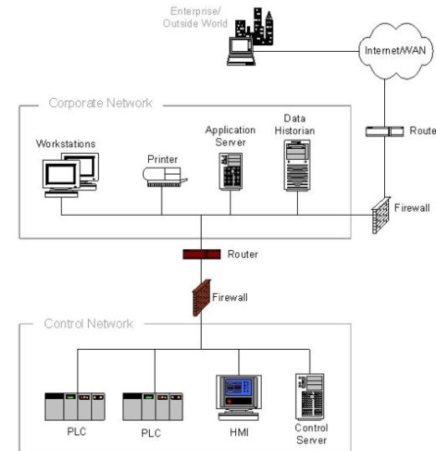
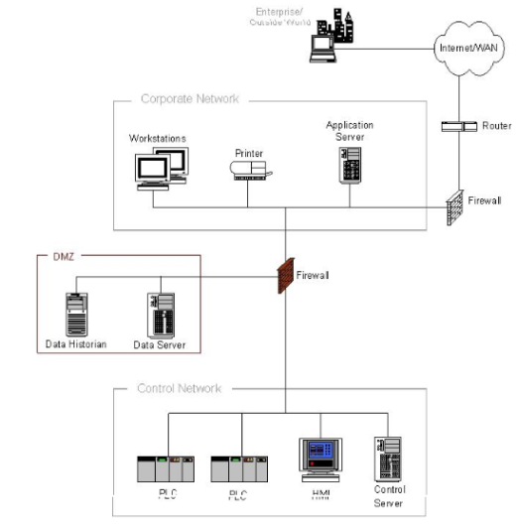
ADVISE Meta Tool on Möbius
Compare architecture metrics: common attack paths, time to compromise, probability of compromise, cost of attack,…
Architecture 1
Architecture 1 Security metrics
Möbius
Tool
Architecture 2 Security metrics
Architecture 2
Attack simulation
Example architectures: NIST 800-82 Figures 5-2 and 5-3

Slide 5
Workshop Goals
Introduce the tool to the community
Gather feedback about all aspects of the tool
  High level concepts
  Workflow
  User Interface
  Usability
Feedback discussion at the end of each hands-on session

Slide 6
Agenda
Registration and Continental Breakfast
Welcome
Goals
  Tool
  Workshop
Steps to Use ADVISE Meta
Hands on Sessions
Case Studies and Custom Ontologies
Wrap Up

Slide 7
Using ADVISE Meta
Step 1:
Define purpose of analysis
‒Analysis questions, concerns, scope
Step 2:
Model System(s)
‒Define system components, relationships and attributes
‒Hosts, devices, applications, data, networks, firewalls, authentication, other countermeasures
‒Goals: View/modify data, install malware, gain network access, disable
device, damage device…
‒Select from standard adversary types, customize
‒Set goal priorities of various adversaries
‒Generate attack execution graph (AEG)
Step 3:
Adversaries, Goals, Metrics, and Attack Paths Generation
Step 4:
Create and Execute Simulation
‒ Create and run simulation of adversary
behavior
Step 5: Interpret Results
‒Metric Values
‒Visual display of common attack paths

Slide 8
Agenda
Registration and Continental Breakfast
Welcome
Goals
  Tool
  Workshop
Steps to Use ADVISE Meta
Hands on Sessions
Case Studies and Custom Ontologies
Wrap Up

Slide 9

Step 0 – Install and Ontology Overview
When you start Mobius, you will see two tabs in the upper left hand corner
The Project tab contains projects with models of systems, attackers, and metrics.
The Ontology tab is where individual system components, relationships, attributes, etc. are defined.
Notes:
The purpose of this slide is to talk about the two different tabs presented on the left side when you open Mobius

Slide 10
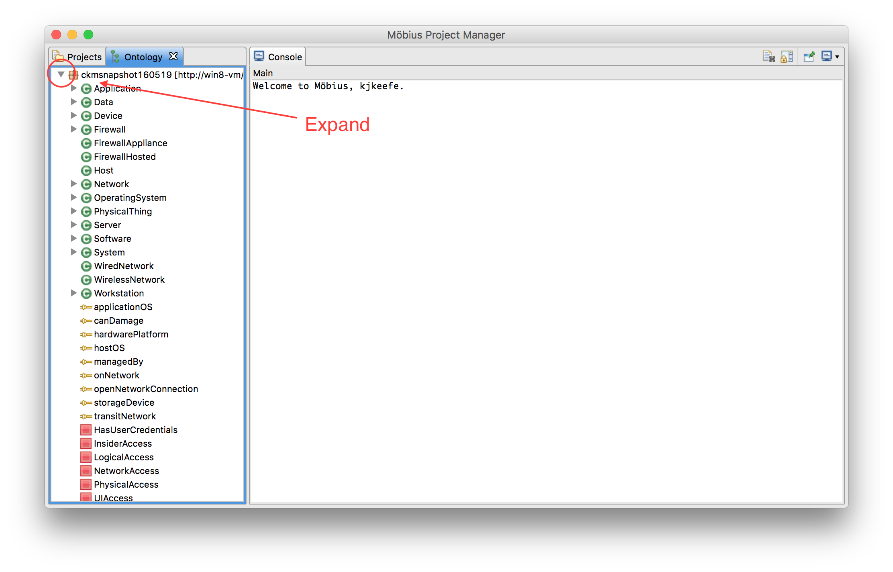
Step 0 – Install and Ontology Overview
On the ontology pane, click on the arrow to left of the ontology name, to expand the ontology
Notes:
The purpose of this slide is to talk about the two different tabs presented on the left side when you open Mobius

Slide 11
ADVISE Meta - Ontology
Ontology (general definition): a particular theory about the nature of being or the kinds of things that have existence
ADVISE Meta Ontology: types of things available to build a system model and simulate cyber attacks against it
Concepts in tool ontology fall in these categories
  Types of components
  Attributes of components by type
  Relationships between components
  Types of access, skills, and knowledge an adversary may have
  Types and characteristics of adversaries
  Attack steps
  State variables: other system, component, or adversary properties

Slide 12
Base Ontology
Base ontology used for hands-on exercise
Representative of tool capabilities
Grounded by:
  Research on attack methods
  Study of example analysis previously done with hand-created AEG
Not yet a “complete” or vetted dataset
Modifiable, replaceable (more on this later)

Slide 13
Base Component Ontology and Inheritance
networkEncryption Strength
KineticDamagePhysicalThing
GainLogical
Access
LogicalDisable
mediaPort
Enabled
Attribute
Attack step

Slide 14
Base Ontology Relationships

Slide 15
Base Ontology Types of Access
PhysicalAccess(X), where X is a PhysicalThing
  Not achievable via any attack step, must be given as initial condition
NetworkAccess(X), where X is a Network
  Able to read and write bits on the network
UIAccess(X), where X is a Device or Software
  Able to touch the login function (if any)
HasUserCredentials(X), where X is a Device or Software
  Has the password, token, key, or other credential required to access user functions provided by X
LogicalAccess(X), where X is a Device or Software
  Able to access user functions provided by X

Slide 16
Base Ontology Skills
See list of skills on ontology tab with symbol
Adversary templates define default skill proficiencies
Most skills are generic
Reason for adding system specific skills (“Specialized”)
  Model the tremendous advantage they provide to adversary
Reason for using broad skill categories
  Represents how real adversaries accumulate skills
  Fine grained skill proficiencies (e.g. at stealing passwords or breaking VPNs) unlikely to be known or even guessable in an actual case
  Haven’t seen reason yet for increasing data input requirements and complexity in attack step models

Slide 17
Base Ontology Attack Steps
Damage or disable
Malware
KineticDamagePhysicalThing
LogicalDamagePhysicalThing
PhysicalDisable
LogicalDisable
CreateTrustedSiteCauseMalwareInstall
CreateUnTrustedSiteCauseMalwareInstall
CreateRemovableMediaCauseMalwareInstall*
StagePackageCauseMalwareInstall*
InstallMalwareFromFixedMedia*
InstallMalwareFromRemovableMedia*
Gain access
GainLogicalAccess
GainUserCredentials
GainLocalUIAccessDevice
GainLocalUIAccessOS
GainRemoteUIAccessDev
GainRemoteUIAccessOS GainNetworkAccessViaNetworkNode GainNetworkAccessViaNodeOnConnectedNetwork
GainNetworkAccessViaConnectedNetwork AdminModifyFWOpen
CircumventFWRules
PlaceRogueHostOnNetwork
*Not in alpha
Compromise data integrity
Compromise data confidentiality
ModifyDataLocally
ReadManagedDataLocally
NetworkEavesdrop

Slide 18
Fragment of Attack Execution Graph (AEG)
AEG describes potential attack paths from attacker viewpoint
Attack step attempt requires certain access, skills, knowledge and/or system state conditions
Attack outcome can affect any of these elements
Any of these elements may be selected as an adversary goal
Logical Access
(to Firewall F on network N)
Firewall
Ruleset Knowledge
(for F)
Network Penetration Skill
Precondition
AdminModifyFWOpen (on F)
Effect
Network
Access
(to N)
Precondition
NetworkEavesdrop
(data D that transits N)
Effect, Adversary Goal
Data In Transit Viewed
(D)

Slide 19
Hands-on Example Step 1 – Define Purpose of Analysis
What kinds of systems can be analyzed?
With the base ontology: Enterprise system architectures that may have:
  Networks hosting cyber and cyber-physical devices
  Applications, data
  Internet connections
  Boundary protections and other common countermeasures
  Design phase or existing
With arbitrary ontology:
  In theory, any system built of components, where attacks are constructed by linking attack steps against components

Slide 20
Example Enterprise Systems
Architecture to support stock trading
SCADA architecture supporting an electric utility
Control systems in a water treatment plant
Operations and administration systems for a telecommunications provider
911 computer systems architecture
Reactor safety architecture for a nuclear power plant
Systems in a hospital that process patient information
Air traffic or train control systems
Computer infrastructure for a research and development facility
Computer infrastructure for an ISP

Slide 21
Step 1 – Define Purpose of Analysis (cont.)
What kinds of questions can be answered?
How susceptible is a system to cyber attacks?
What can be done to decrease susceptibility?
Typical examples of analyses
Which among alternative architectures should be recommended?
What are security weak points of an architecture?
Is a proposed countermeasure worthwhile?
How will proposed functional architecture changes impact security?
  If security decreases, how can decrease be minimized?

Slide 22

Step 1 – Define Purpose of Analysis – Small SCADA Networks
Engineering
Workstation
Corporate
Network
Engineering
Network
SCADA
Network
HMI
Predicted electricity demand data stored on the SCADA LAN is found on the desk of an engineer not authorized to view this data. This data can be sold to competing electricity vendors to aid in their pricing.
How could the engineer even gain access to the SCADA LAN?
The engineer has physical access to all networks shown and to the HMI, and is an authorized user of the engineering workstation.
What changes to the architecture would make this less likely to happen again?

Slide 23
Step 1 – Define Purpose of Analysis - Feedback
Open questions/discussion on Step 1
Questions for group:
  What are some typical security architecture decisions for which rationale is hard to come by?
  Are there specific systems that don’t fall under enterprise systems, but that might benefit from this type of analysis?

Slide 24
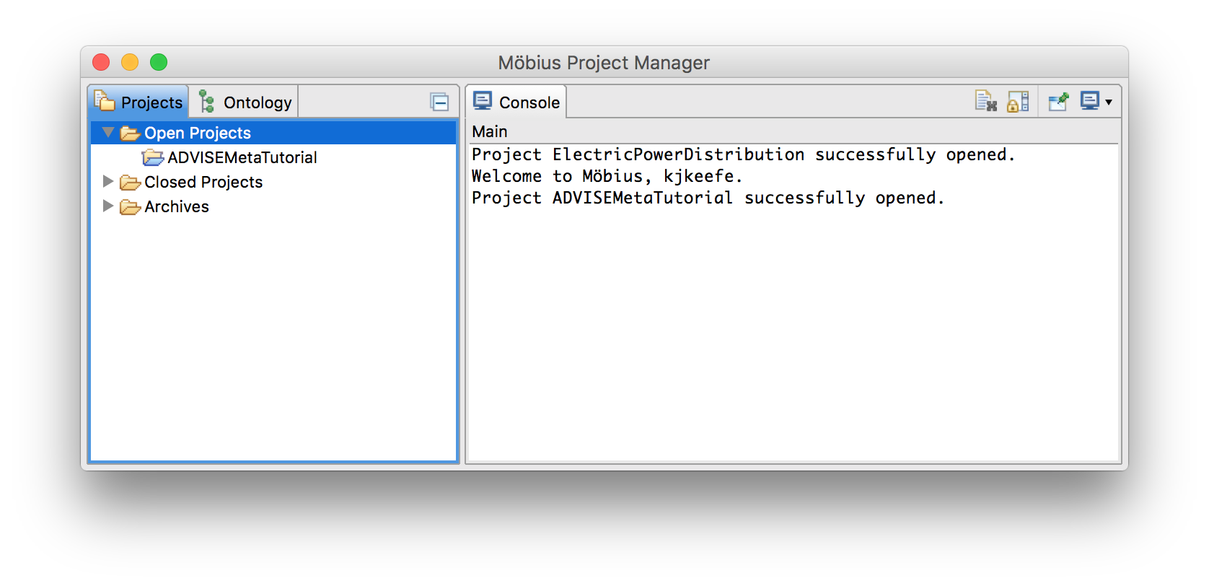
Step 2 – Model Systems
Select the Projects tab.
Right click Open Projects and select New Project…
Name the project ADVISEMetaTutorial and click Finish
Notes:
The purpose of this slide is to talk about the two different tabs presented on the left side when you open Mobius

Slide 25
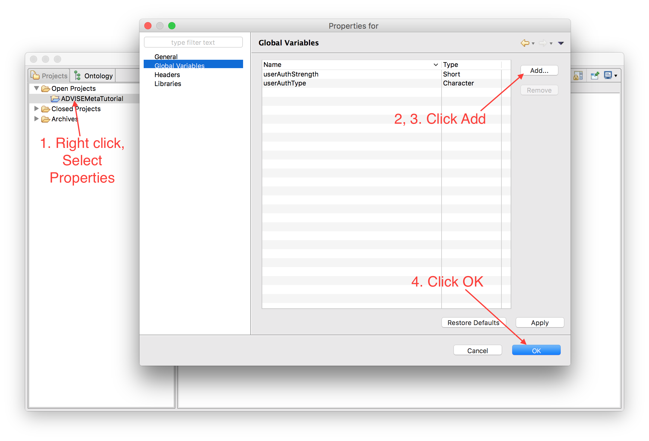
Step 2 – Model Systems
Right click the ADVISEMetaTutorial project, select Properties…
Add a global variable called userAuthStrength with type Short.
Add a global variable called userAuthType with type Character.
Click OK
Notes:
The purpose of this slide is to talk about the two different tabs presented on the left side when you open Mobius

Slide 26
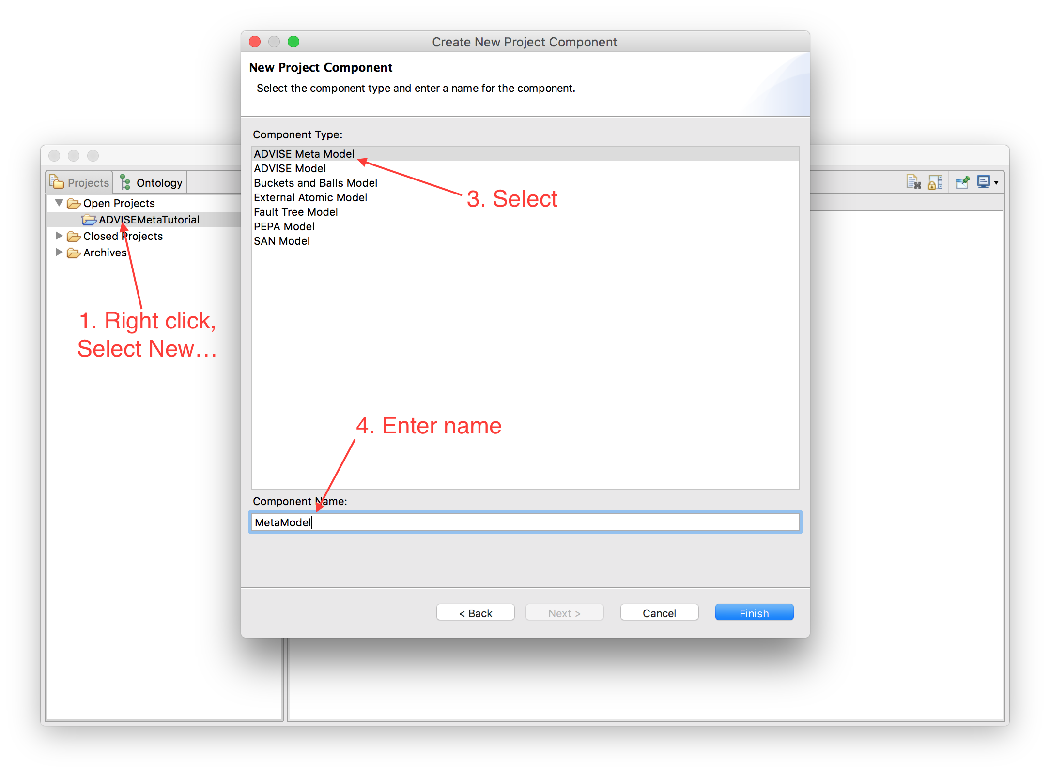
Step 2 – Model Systems
Right click the ADVISEMetaTutorial project, select New…
Select Atomic in the bottom pane and click Next.
Select ADVISE Meta Model in the list.
Enter the name MetaModel and click Finish.
Notes:
The purpose of this slide is to talk about the two different tabs presented on the left side when you open Mobius

Slide 27
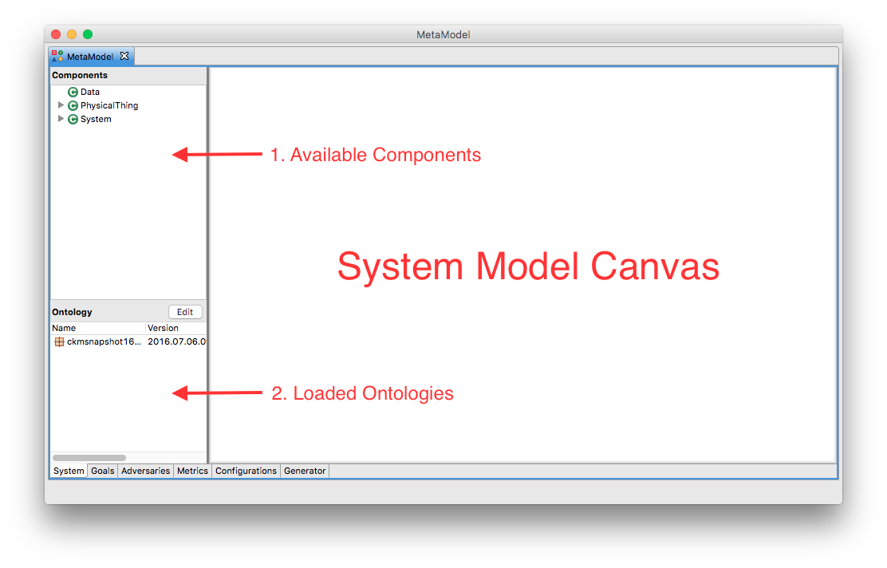
Step 2 – Model Systems

Slide 28


Step 2 – Model Systems
Component
  Part or element of the system
  Physical objects, e.g., computer, firewall, building, etc.
  Logical objects, e.g., data, software, etc.
  Components are represented as blue rectangles on the system diagram
Relationship
  A semantic connection between two components.
  For example, a computer is connected to a network through a onNetwork relationship, or data is managed by a software application through a managedBy relationship.
  Relationships are represented as arcs on the system diagram.

Slide 29
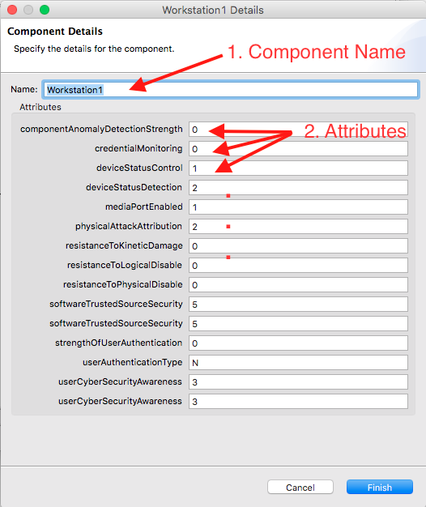
Step 2 – Model Systems
Attributes
  Security relevant properties associated with a component
  For example, a component might use a specific type of authentication mechanism
  Listed in the “Details” of the component

Slide 30
Step 2 – Model Systems
Our simple example consists of:
SCADA Network with a local terminal (HMI)
Engineering Network with a local Linux workstation running an SSH server
Corporate LAN
All networks are interconnected through firewalls
Engineering
Workstation
Corporate
Network
Engineering
Network
SCADA
Network
HMI
Notes:
I am assuming we are only looking at the project side. This means that I am assuming they are importing the ontology somehow.
The SCADA Network contains all of the control devices
The Engineering Network contains the workstations for engineers maintaining the system through the SCADA network
The Corporate Network contains the workstations that are more part of the corporation. These might include a historian or billing system for example.

Slide 31
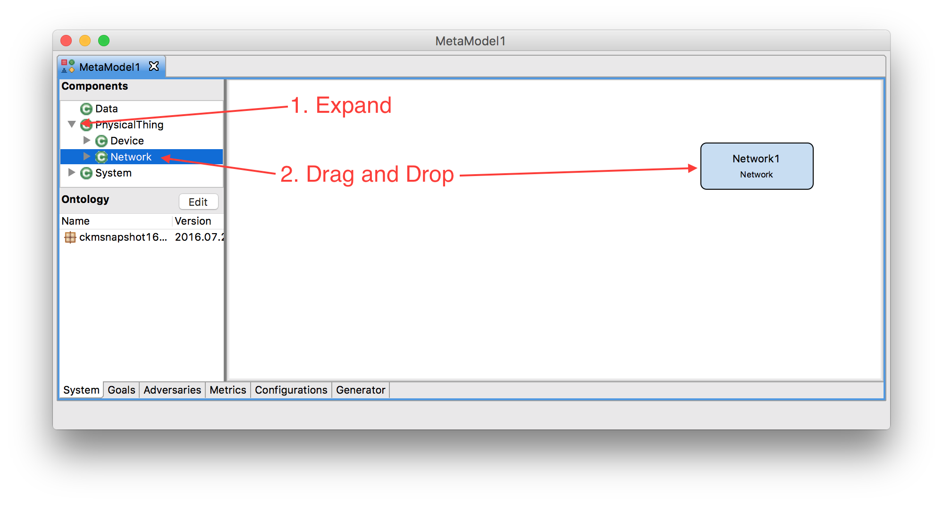
Step 2 – Model Systems
Expand the PhysicalThing node in the available components tree.
Drag and drop an instance of a Network onto the canvas.
Notes:
The purpose of this slide is to talk about the two different tabs presented on the left side when you open Mobius

Slide 32
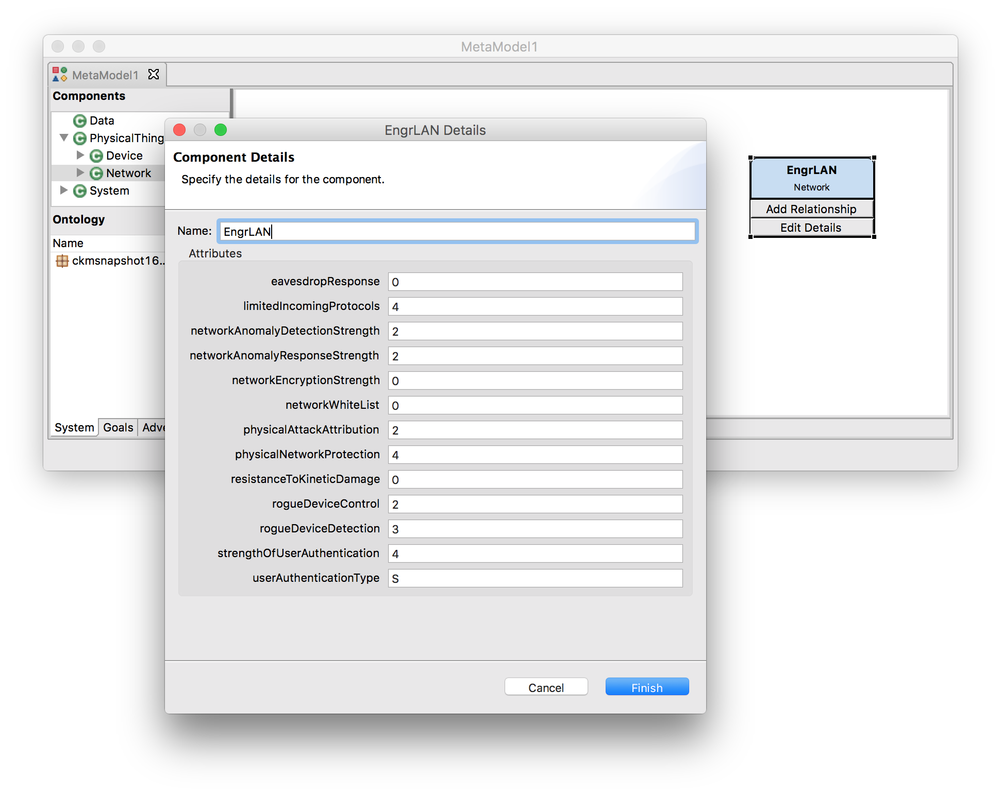
Step 2 – Model Systems
Select the Network1 component and click the Edit Details button.
Change the name to EngrLAN and click Finish.
Notes:
The purpose of this slide is to talk about the two different tabs presented on the left side when you open Mobius

Slide 33
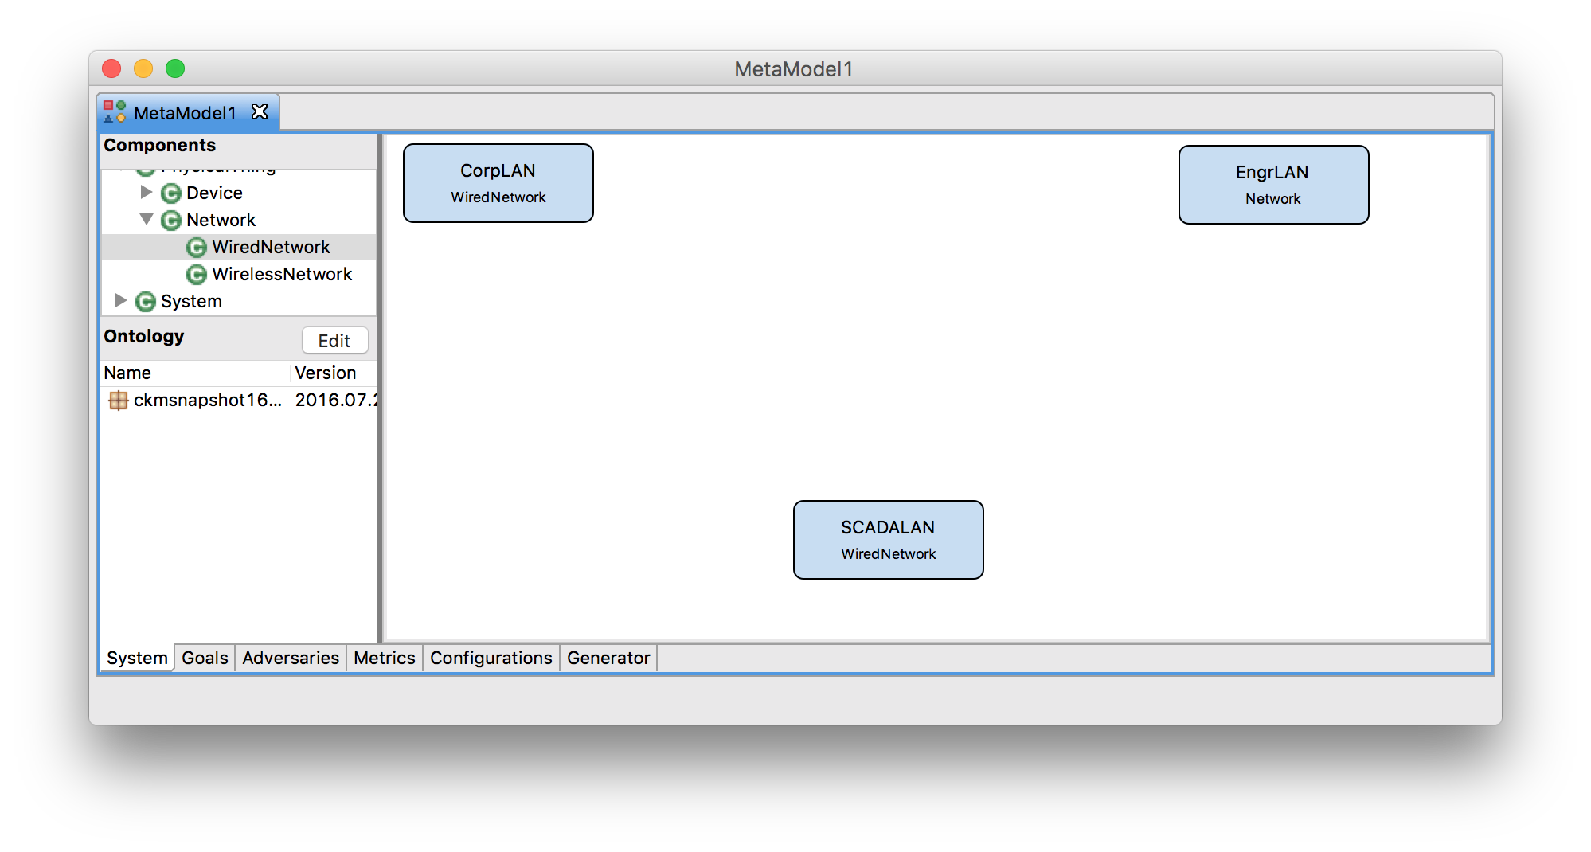
Step 2 – Model Systems
Create a WiredNetwork called CorpLAN
Create a WiredNetwork called SCADALAN
Notes:
The purpose of this slide is to talk about the two different tabs presented on the left side when you open Mobius

Slide 34
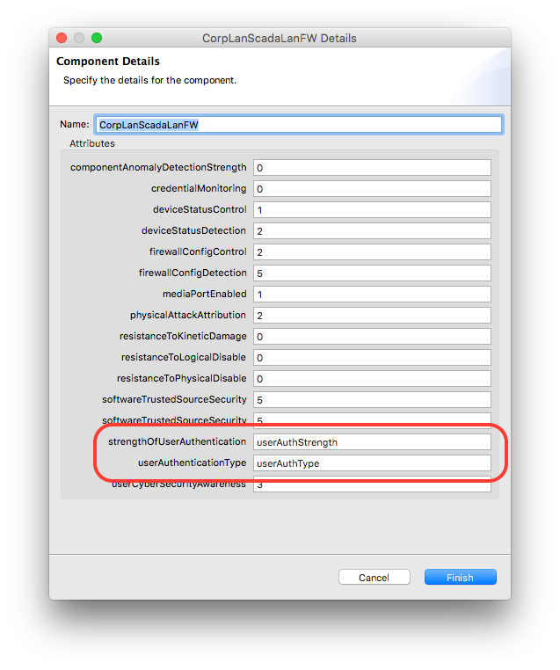
Step 2 – Model Systems
Create a FirewallHosted and define its attributes like so:
Attribute | Value
Name | CorpLanScadaLanFW
strengthOfUserAuthentication | userAuthStrength
userAuthenticationType | userAuthType
Notes:
The purpose of this slide is to talk about the two different tabs presented on the left side when you open Mobius

Slide 35
Step 2 – Model Systems
Create another FirewallHosted
Create another FirewallHosted
Attribute | Value
Name | CorpLanEngrLanFW
strengthOfUserAuthentication | userAuthStrength
userAuthenticationType | userAuthType
Attribute | Value
Name | EngrLanScadaLanFW
strengthOfUserAuthentication | userAuthStrength
userAuthenticationType | userAuthType
Notes:
The purpose of this slide is to talk about the two different tabs presented on the left side when you open Mobius

Slide 36
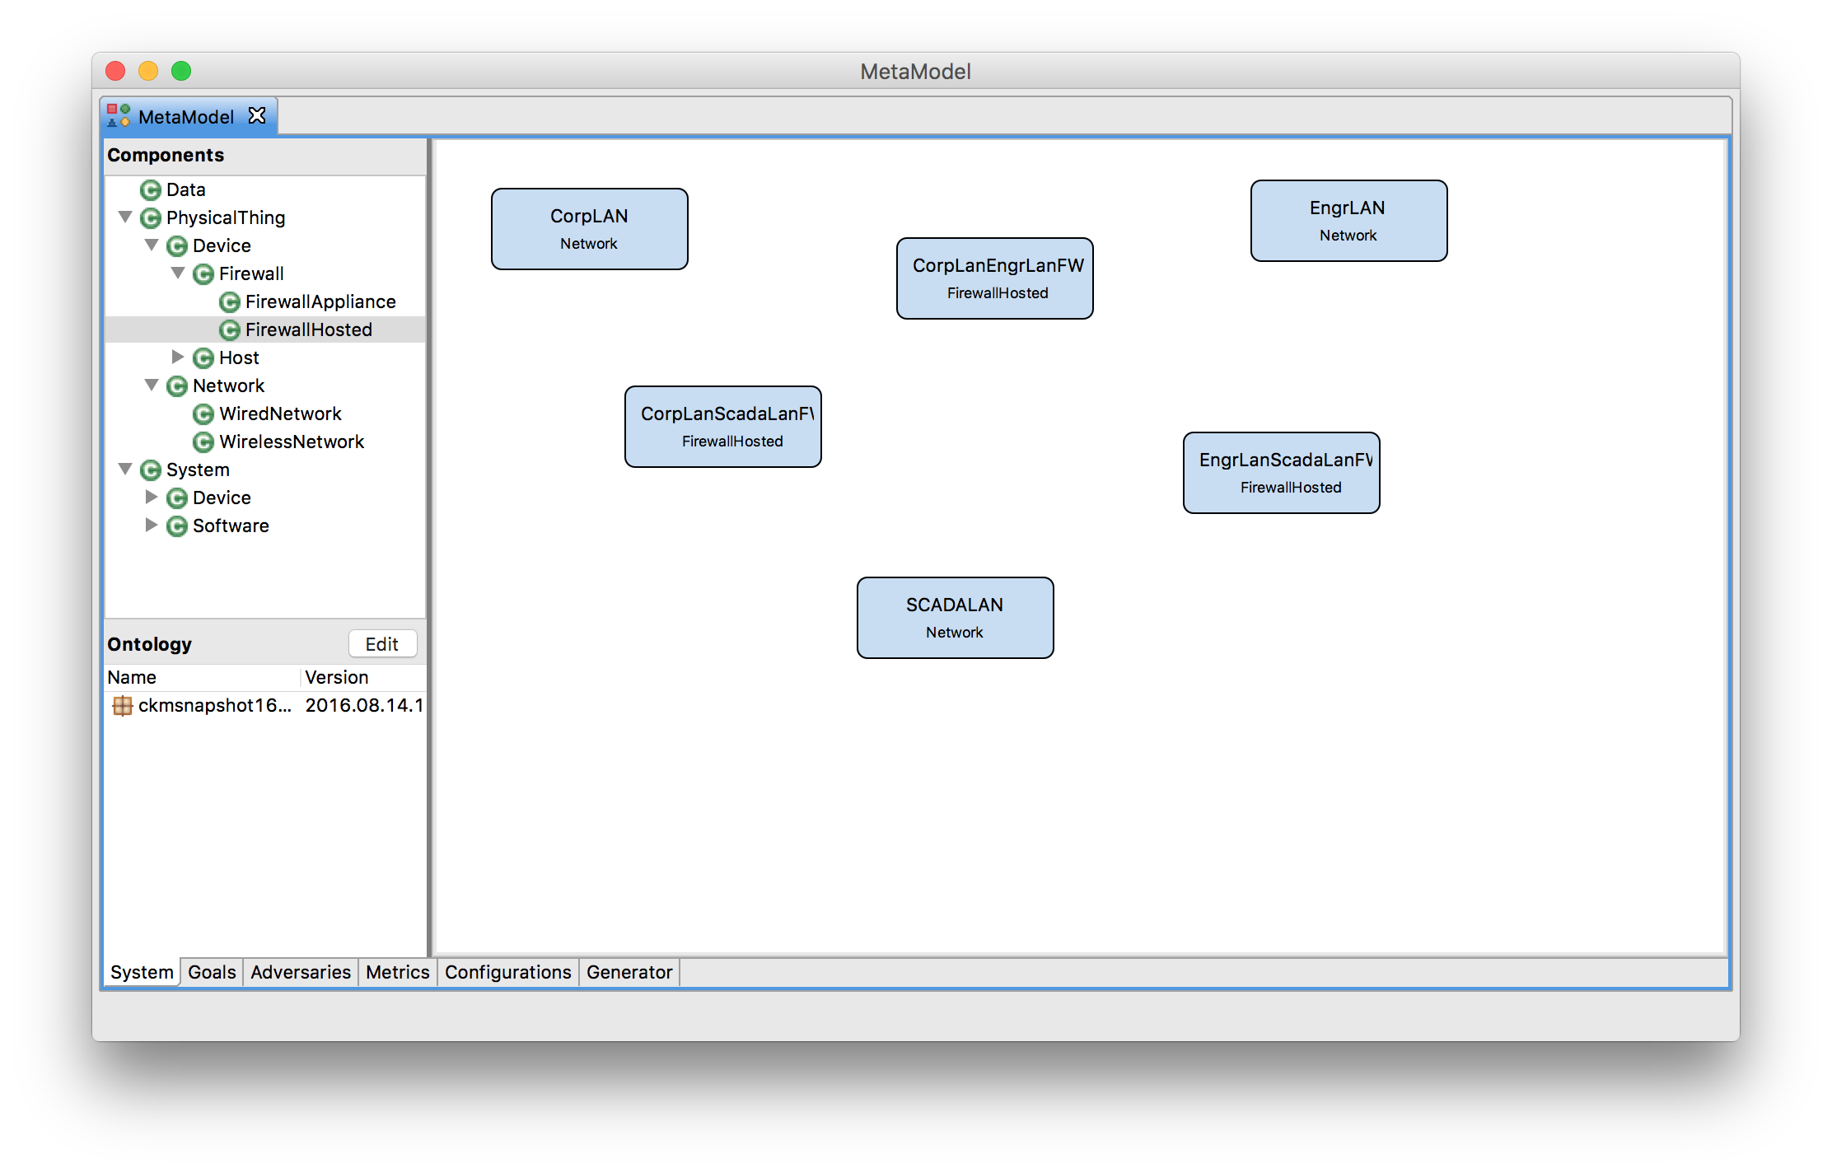
Step 2 – Model Systems
Notes:
The purpose of this slide is to talk about the two different tabs presented on the left side when you open Mobius

Slide 37
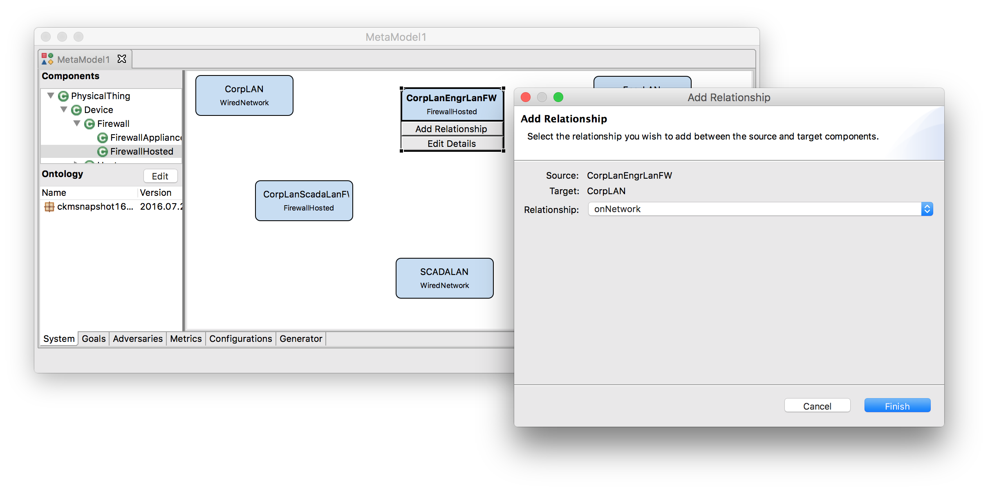
Step 2 – Model Systems
Select the CorpLanEngrLanFW component and click the Add Relationship button.
Select the CorpLan component.
Select the onNetwork relationship and click Finish.
Notes:
The purpose of this slide is to talk about the two different tabs presented on the left side when you open Mobius

Slide 38
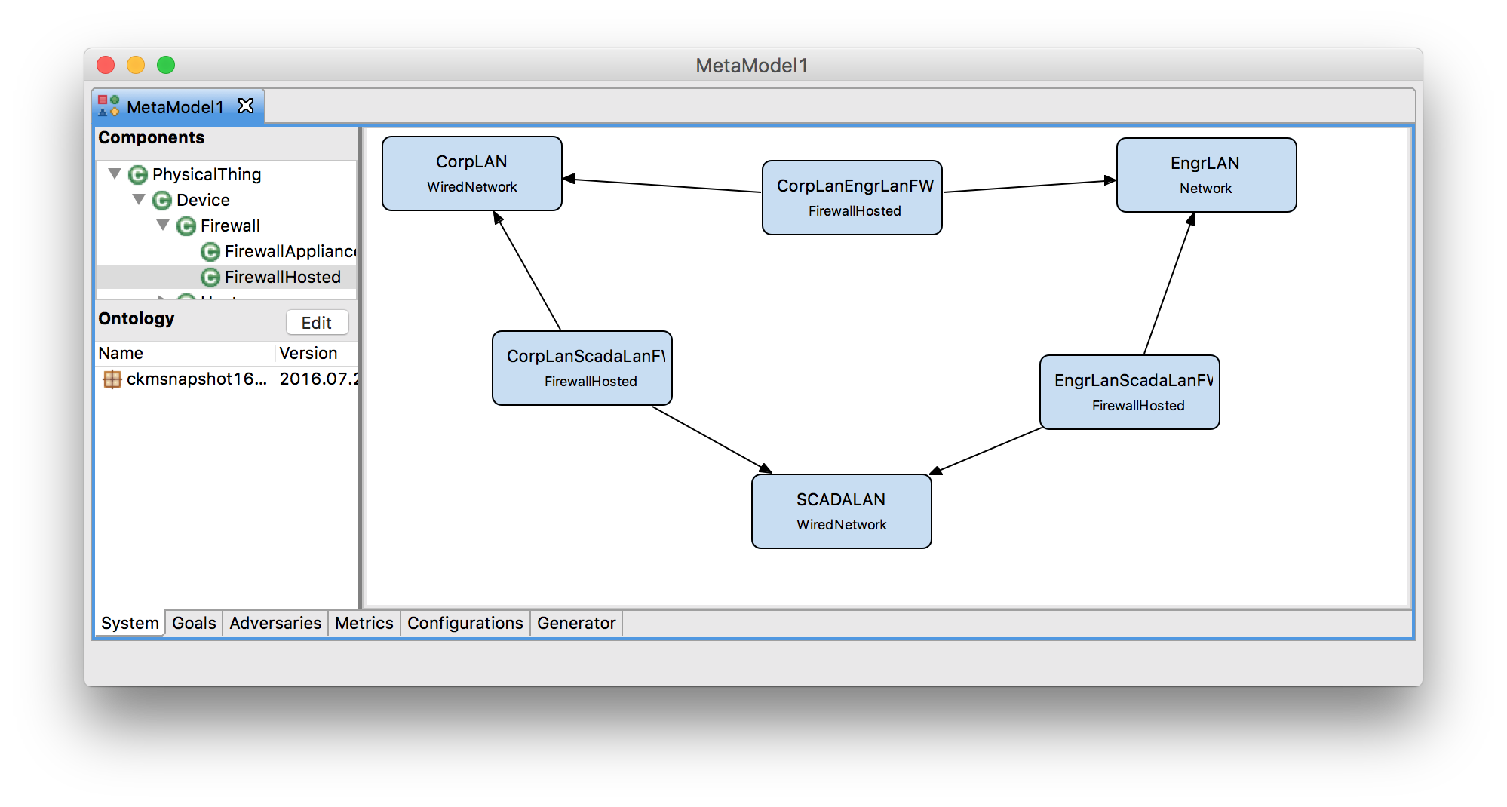
Step 2 – Model Systems
Create additional onNetwork relationships between:
  CorpLanEngrLanFW to EngrLAN
  CorpLanScadaLanFW to CorpLAN
  CorpLanScadaLanFW to SCADALAN
  EngrLanScadaLanFW to EngrLAN
  EngrLanScadaLanFW to SCADALAN
Notes:
The purpose of this slide is to talk about the two different tabs presented on the left side when you open Mobius

Slide 39
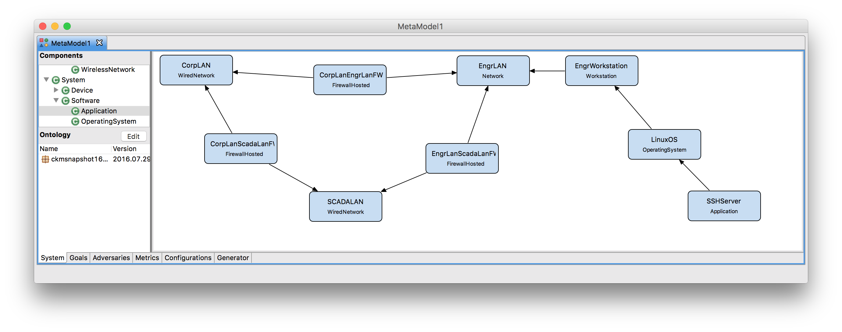
Step 2 – Model Systems
Create a Workstation called EngrWorkstation
Define an onNetwork relationship from EngrWorkstation to EngrLAN.
Create an OperatingSystem called LinuxOS.
Define a hardwarePlatform relationship from LinuxOS to EngrWorkstation.
Create an Application called SSHServer.
Define an applicationOS relationship from the SSHServer to LinuxOS.
Notes:
The purpose of this slide is to talk about the two different tabs presented on the left side when you open Mobius

Slide 40
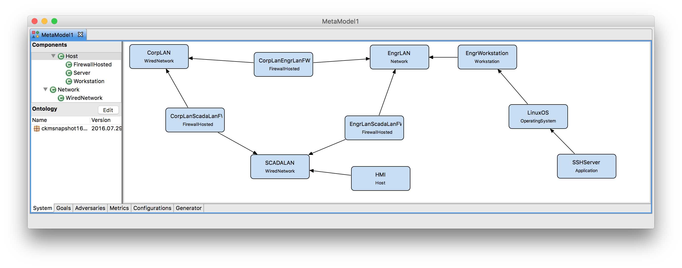
Step 2 – Model Systems
Create a Host called HMI.
Define an onNetwork relationship from HMI to SCADALAN
Notes:
The purpose of this slide is to talk about the two different tabs presented on the left side when you open Mobius

Slide 41
Step 2 – Model Systems – Feedback
How challenging was this step?
Was adding components, creating relationships, and defining attributes easy?
Could this part of the tool be useful for designing system diagrams for uses outside of the tool?
How would you handle larger, more complex models? How would you expect the tool to help you with those models?
Was the available components tree intuitive?

Slide 42
Step 3 – Attack Goals, Adversaries, Metrics, and Generation
Possible attack goals are dependent on the system diagram
  Choose a set of state variables (Access, Skill, Knowledge, SSV) the goal state is a function of.
  Define the functional expression that indicates whether the goal has been achieved.

Slide 43
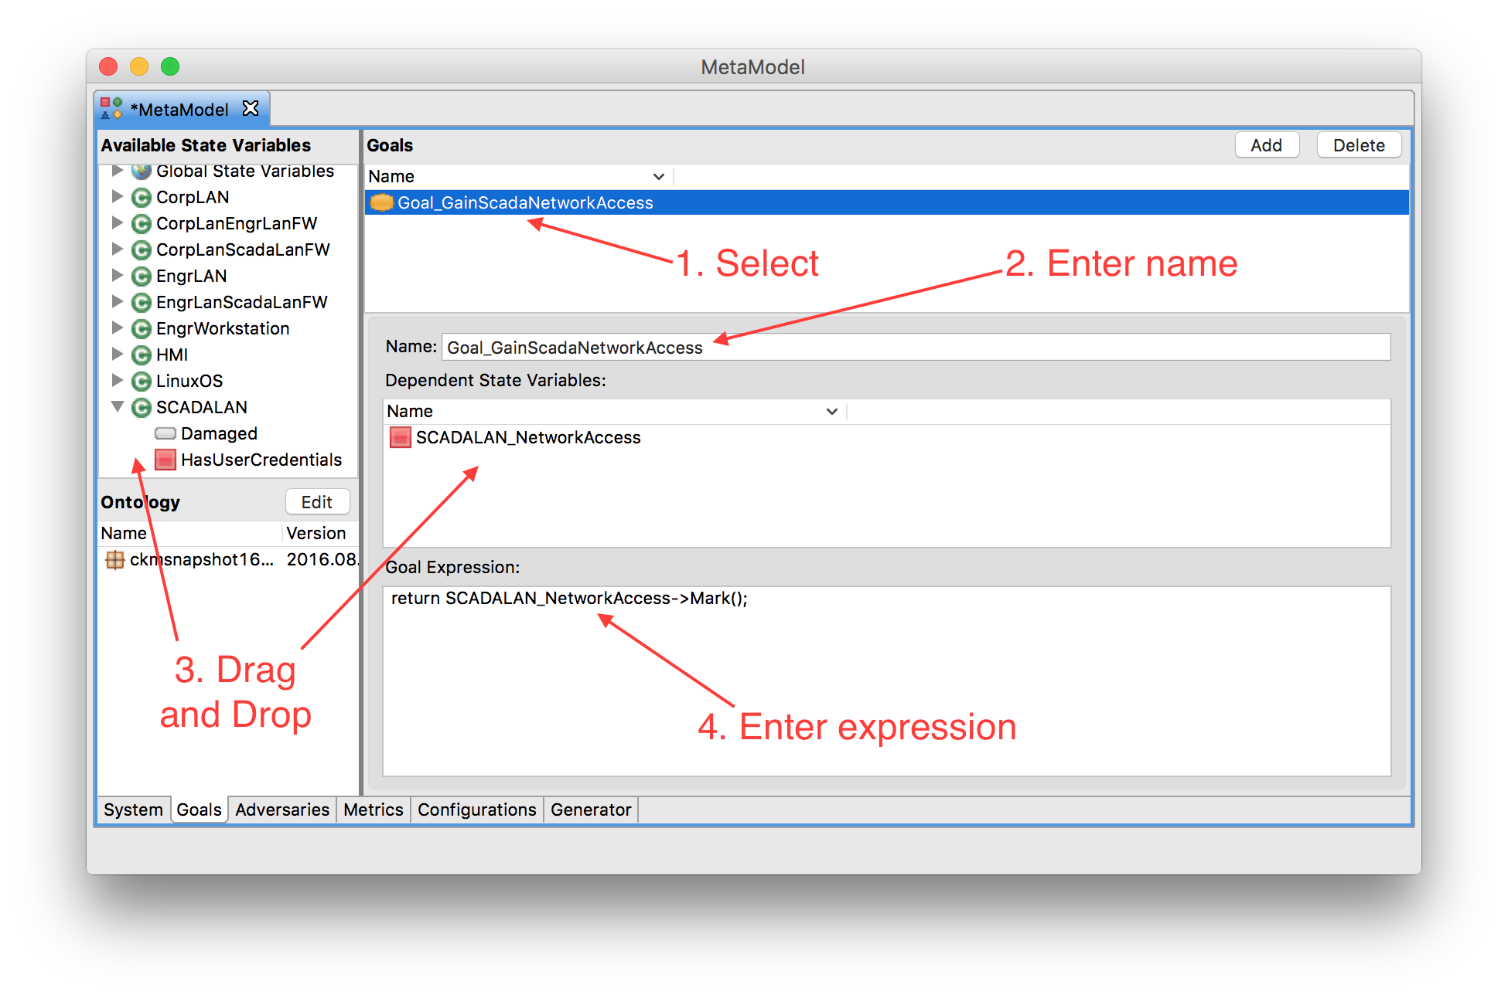
Small SCADA Networks – Step 3
return SCADALAN_NetworkAccess->Mark();

Slide 44
Step 3 – Attack Goals, Adversaries, Metrics, and Generation
Adversaries are created from Adversary Templates (defined in the ontology)
  Attributes are customizable
  Possible initial state depends on system diagram

Slide 45
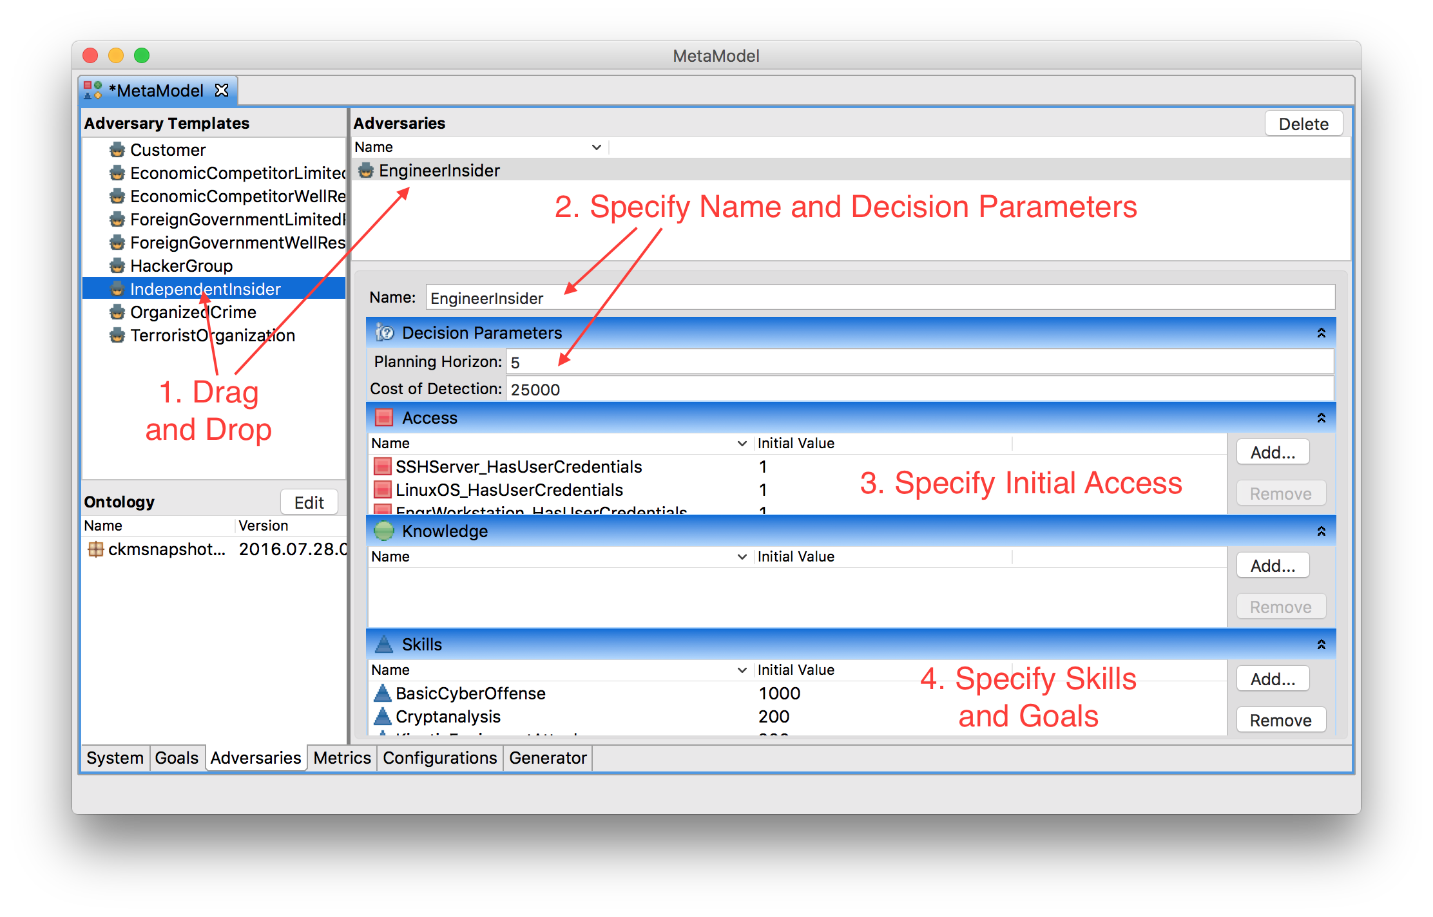
Small SCADA Networks – Step 3

Slide 46
Small SCADA Networks – Step 3
Independent Insider
Name: EngineerInsider
Cost of Detection: 100,000
Access: CorpLAN_PhysicalAccess
CorpLanEngrLanFW_PhysicalAccess
CorpLanScadaLanFW_PhysicalAccess
EngrLAN_NetworkAccess
EngrLAN_PhysicalAccess
EngrLanScadaLanFW_PhysicalAccess
EngrWorkstation_HasUserCredentials
EngrWorkstation_LogicalAccess
EngrWorkstation_PhysicalAccess
EngrWorkstation_UIAccess
HMI_PhysicalAccess
LinuxOS_HasUserCredentials
LinuxOS_LogicalAccess
LinuxOS_UIAccess
SCADALAN_PhysicalAccess
SSHServer_HasUserCredentials
SSHServer_LogicalAccess
SSHServer_UIAccess
Goal: Goal_GainNetworkAccessOnScadaNetwork 50,000

Slide 47
Step 3 – Attack Goals, Adversaries, Metrics, and Generation
Metrics are created from Metric Templates (defined in the ontology)
  Input parameters are defined in the ontology
  Input values specified by the user

Slide 48
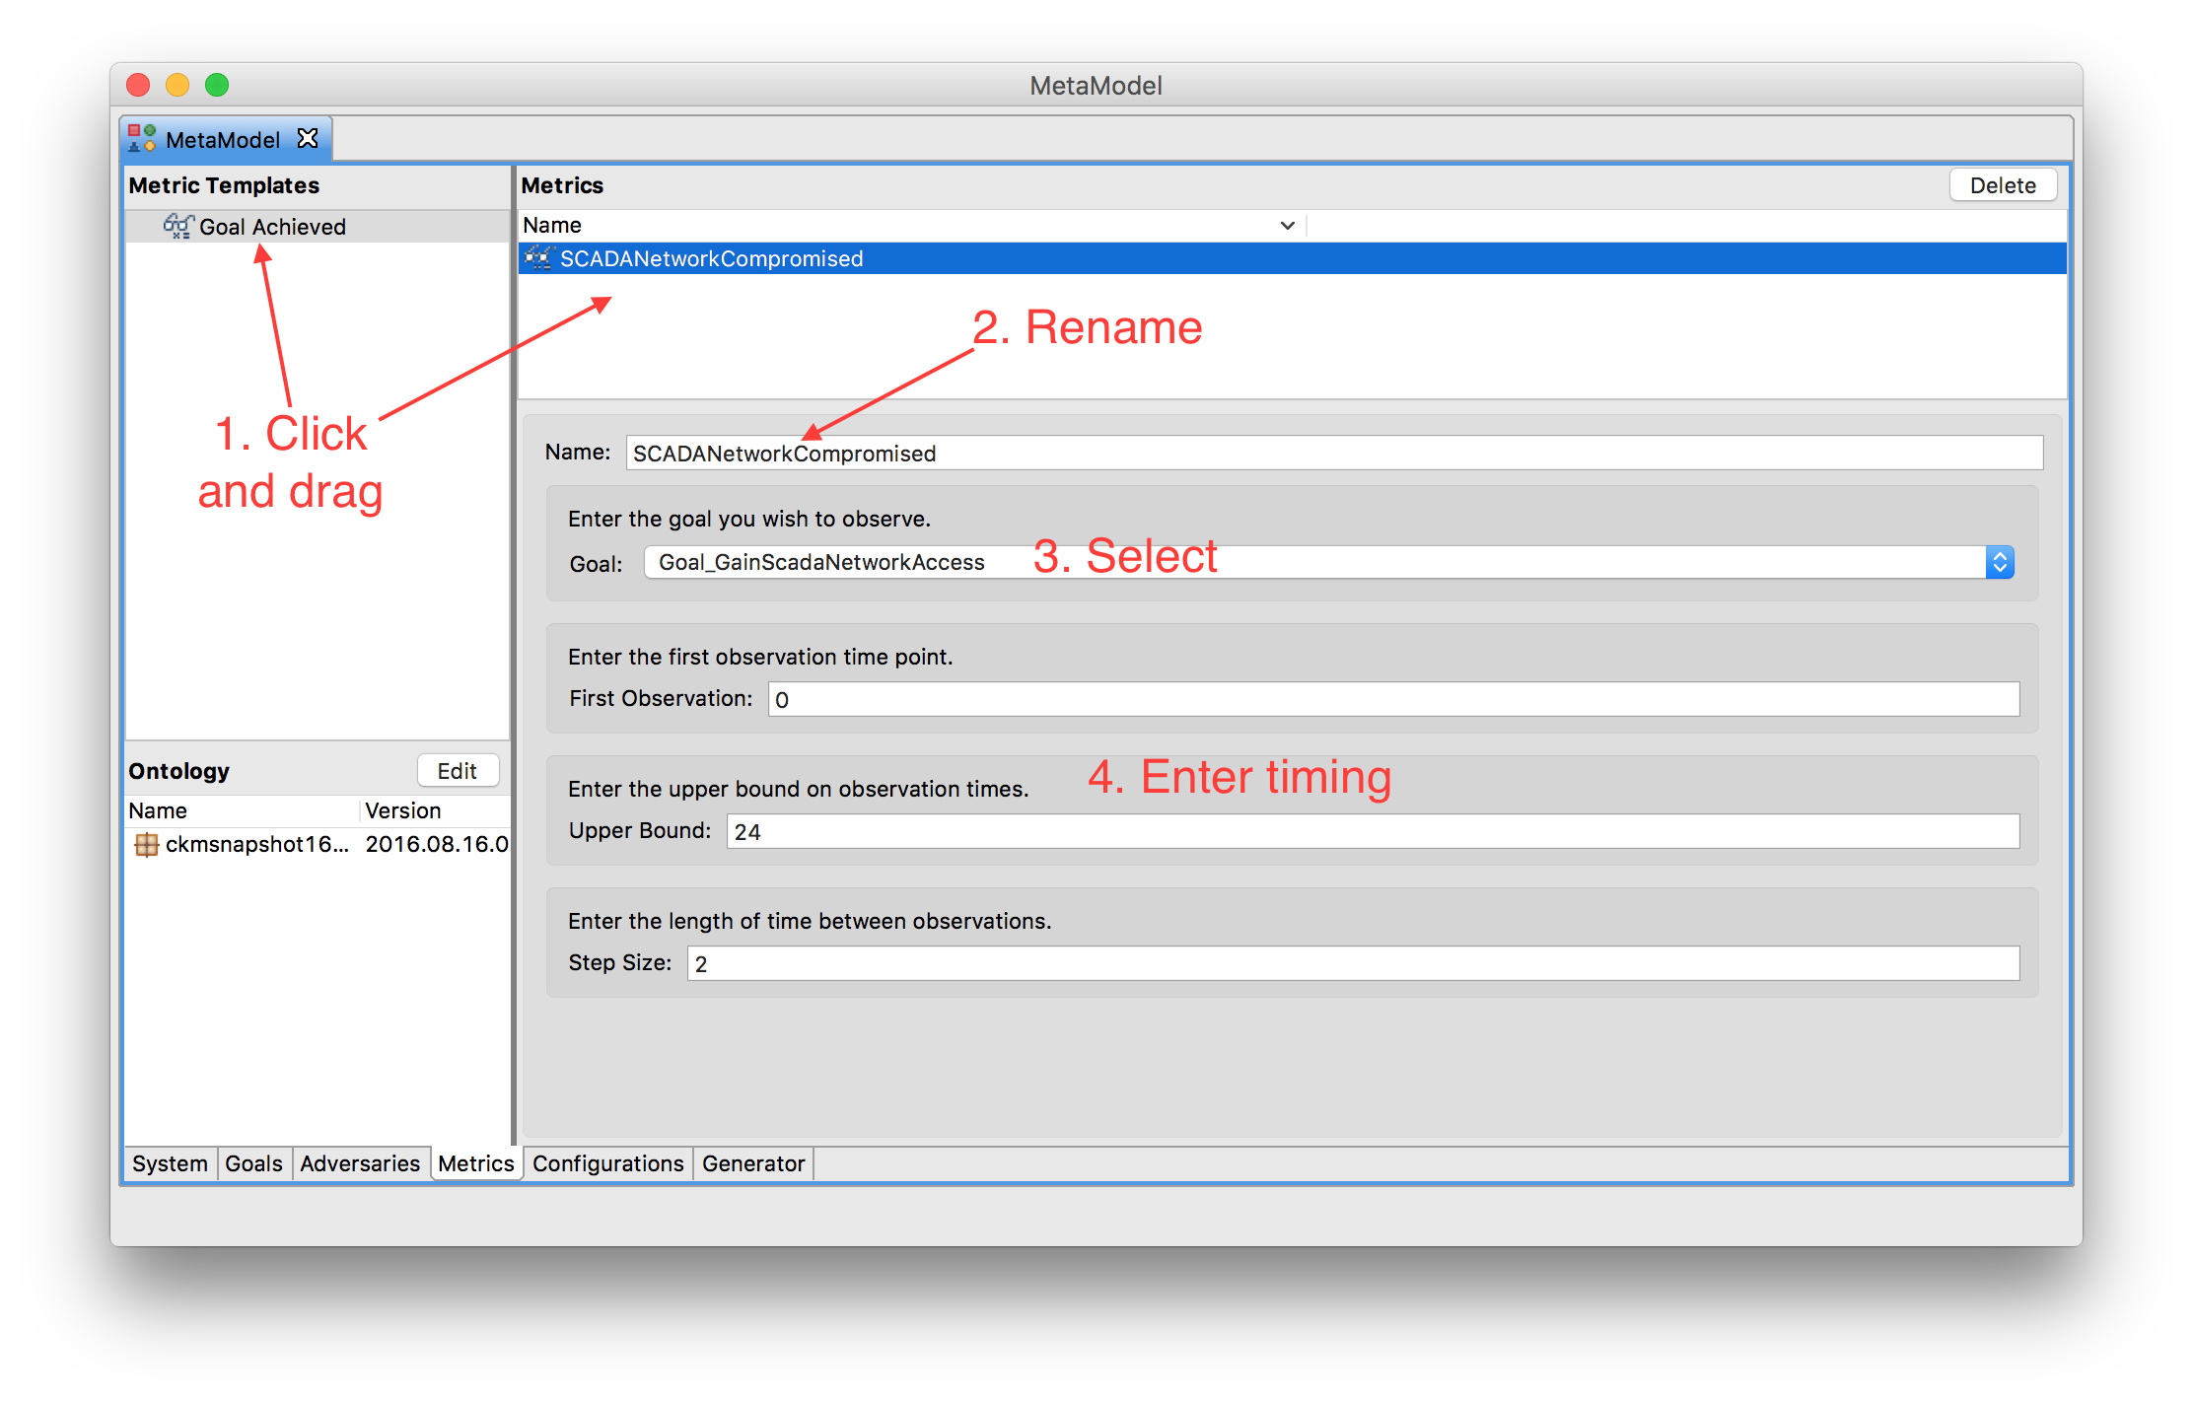
Small SCADA Networks – Step 3

Slide 49
Step 3 – Attack Goals, Adversaries, Metrics, and Generation
Configurations bring together a goal set, an adversary, and a metric set.
  Multiple configurations will generate as one model
  Each configuration will be an experiment
  Simulator will run each experiment separately and report results

Slide 50
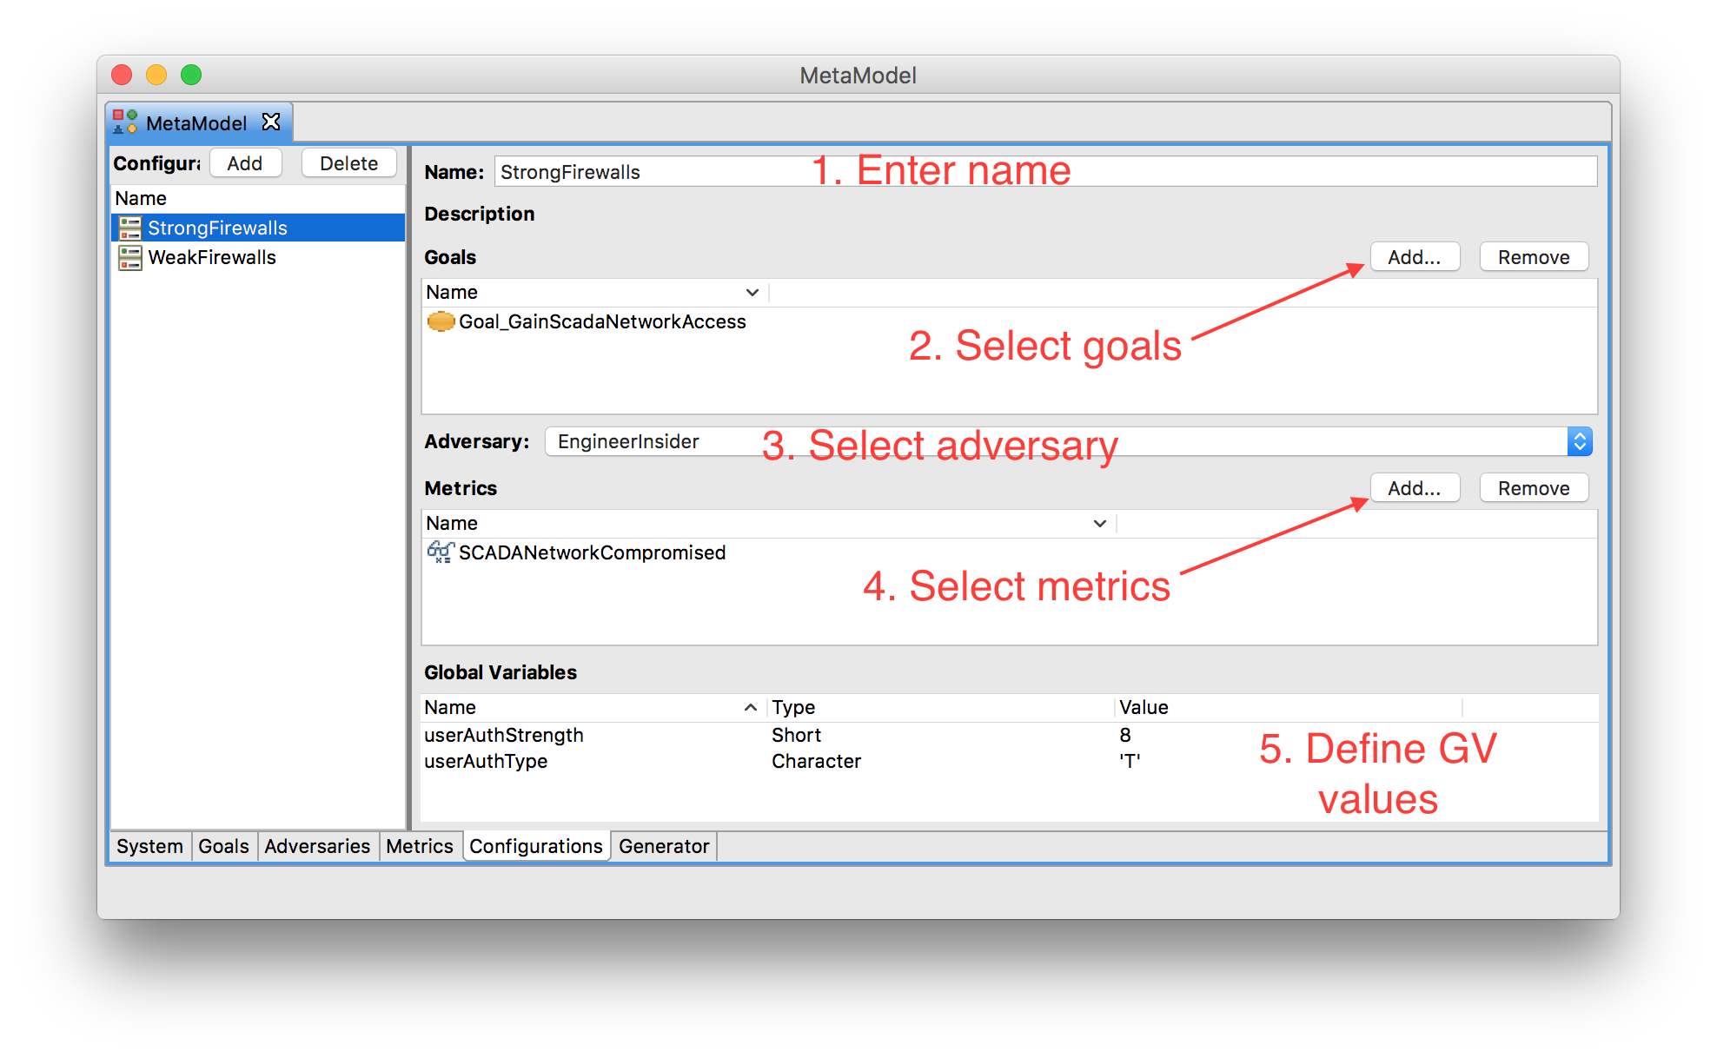
Small SCADA Networks – Step 3

Slide 51
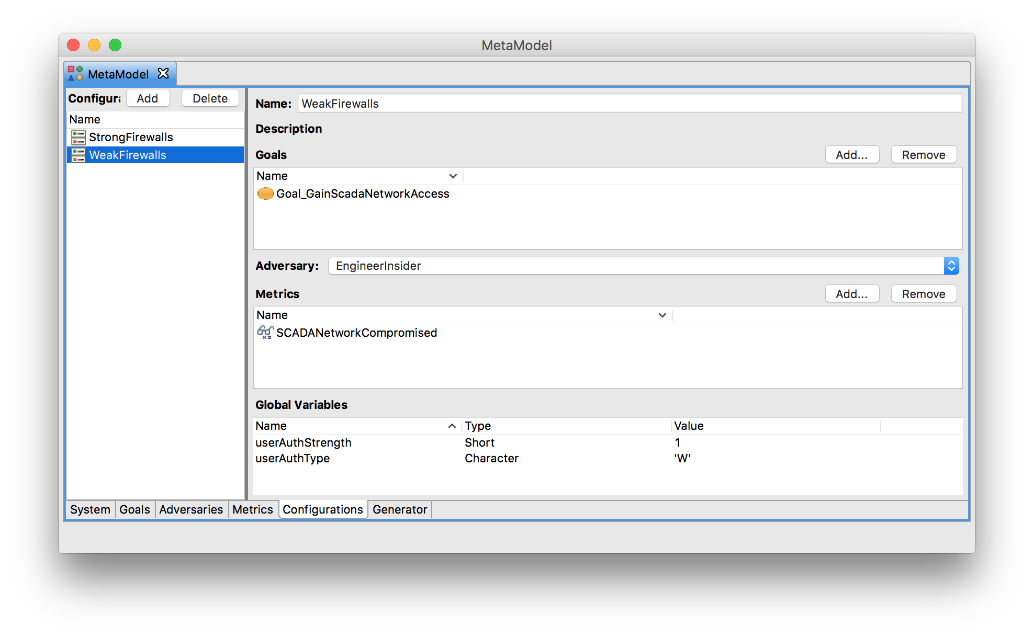
Small SCADA Networks – Step 3

Slide 52
Step 3 – Attack Goals, Adversaries, Metrics, and Generation
The generator creates multiple components in the Mobius Modeling Tool and begins simulation.
  The components are an ADVISE model, a Performance Variables model, a Set study, and a Discrete Event Simulator.
  Simulation should take about a minute.
  Numerical results are show once completed.

Slide 53
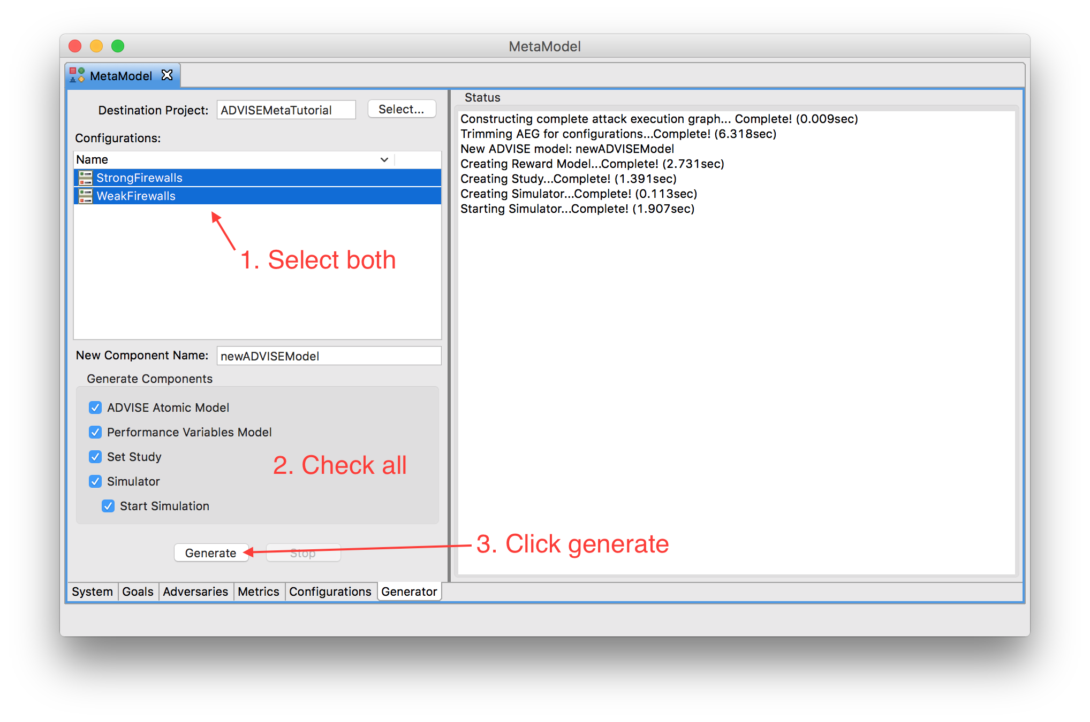
Small SCADA Networks – Step 3

Slide 54
Step 3 – Attack Goals, Adversaries, and Generation – Feedback
How challenging was this step?
Did the goal definition seem intuitive?
What other adversary templates would you look for?
Does the configuration of an adversary’s attributes make sense?

Slide 55
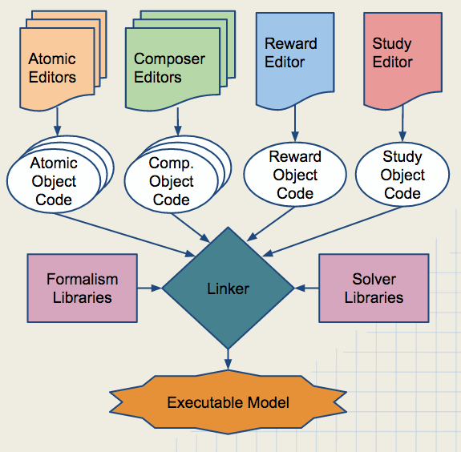
Step 4 – Execute Models
Möbius creates an executable model by:
  Generating C++ code representations of project models
  Compiling the code and linking formalism and solver libraries
  Executing the binary to gather observations and calculate statistics

Slide 56
Step 4 Execute Models - Adversary Decision Cycle
Adversary selects most attractive available attack step in AEG, repeats
State transitions determined by outcome of selected attack step
Current
State s_{i}
Determine all Available Attack Steps in State s_{i}
Adversary weighs cost, detectability and payoff of an attack strategy per their behavior model
Finds max over all paths that start with this attack step, within a lookahead horizon
Choose the
Most Attractive
of the Available Attack Steps
Updated
State s_{k}
Stochastically Select the Attack Step Outcome

Slide 57
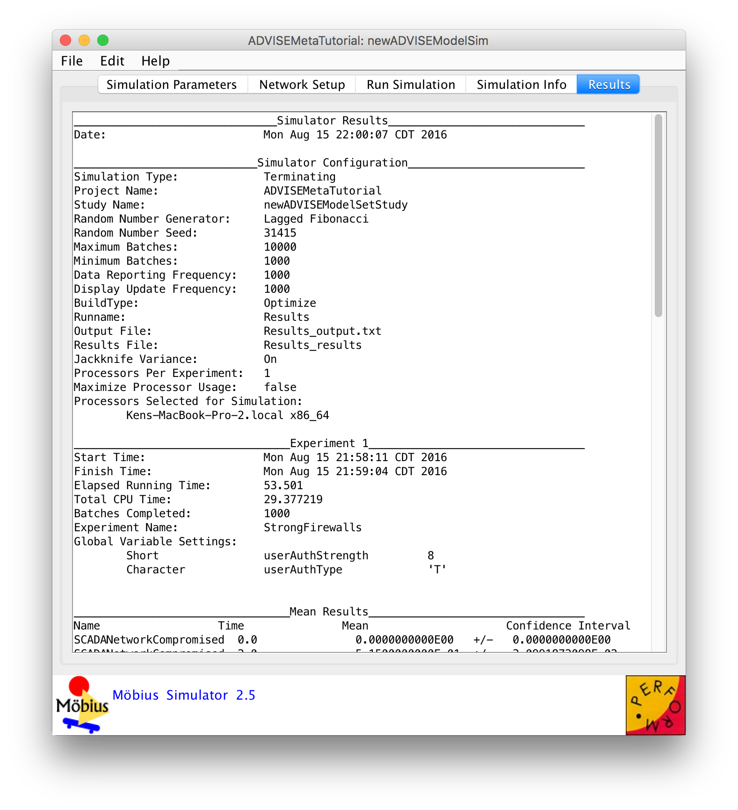
Small SCADA Networks – Step 4
Simulation Is Complete

Slide 58
Step 5 – Interpret Results
We will examine…
  Numerical results from the simulation
  A visual presentation of the model’s behavior

Slide 59
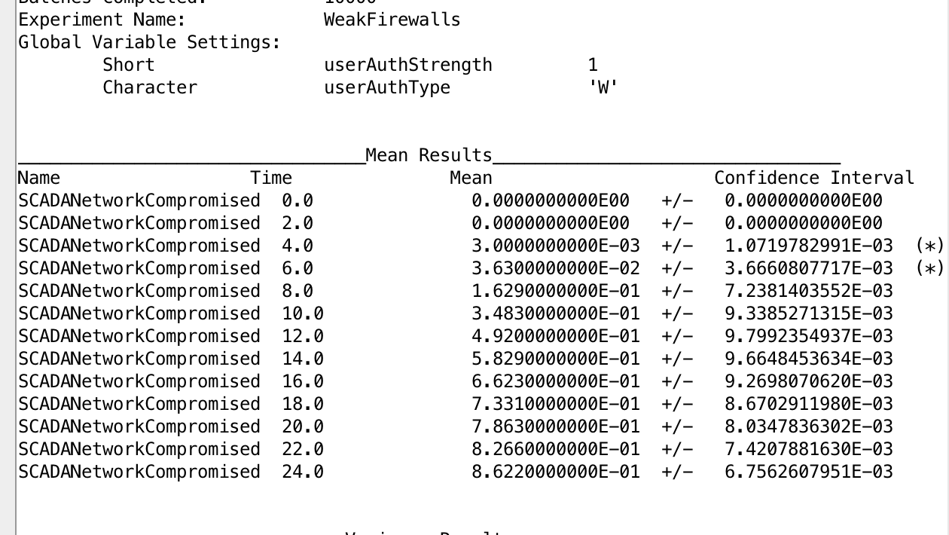
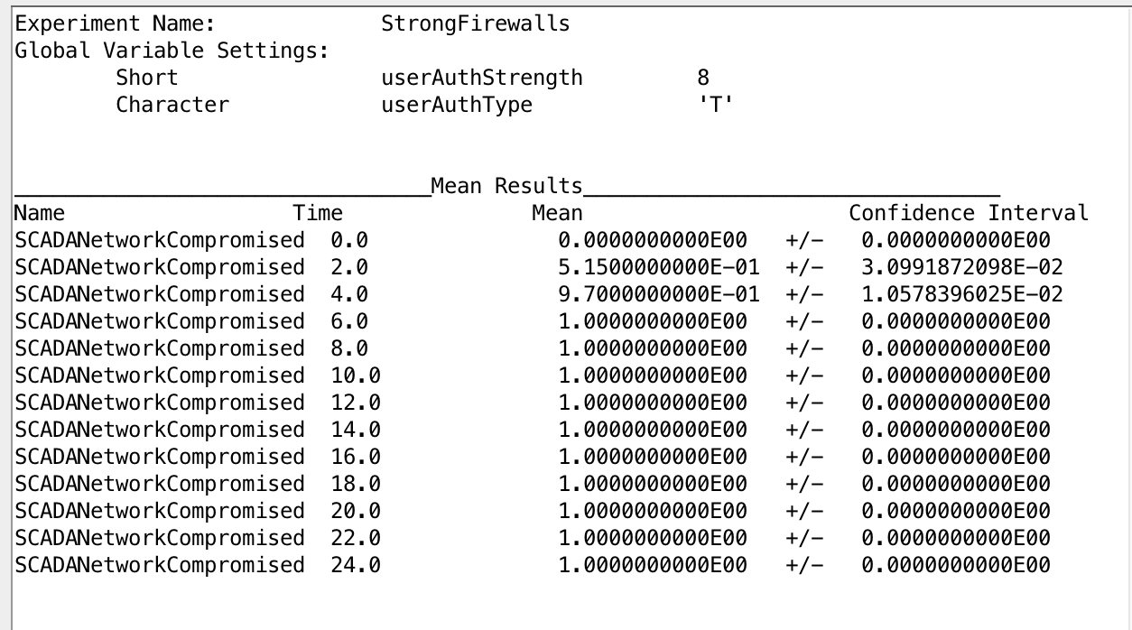
Small SCADA Networks – Step 5
Numerical Results
Adversary was more successful, more quickly when firewalls were hardened.

Slide 60
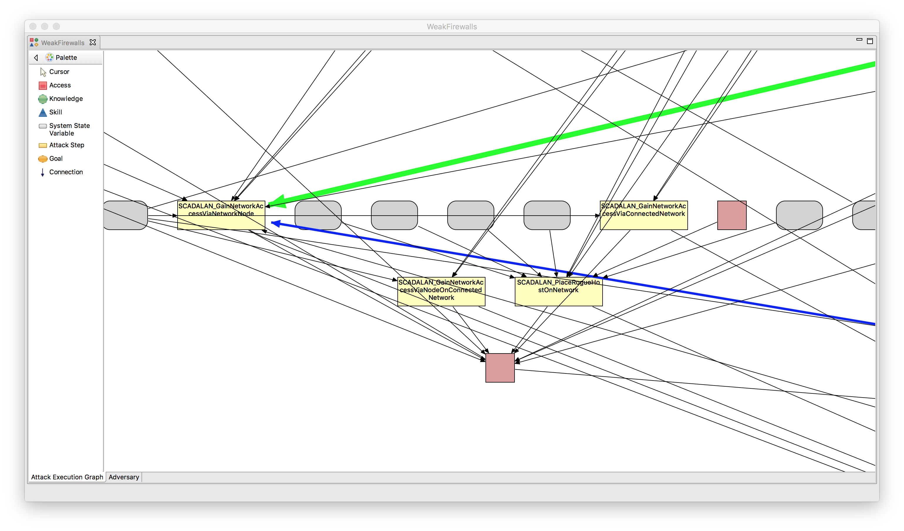
Small SCADA Networks – Step 5
Visual Results
Adversary chose to directly compromise the HMI, rather than go through the firewalls when the firewalls were hardened.

Slide 61
Step 5 – Interpret Results – Feedback
Were you surprised by the results?
Do you believe unexpected results could be useful?
What more would you like to know about the model to make design decisions based on what you’ve learned?
How could the results presentation be improved?

Slide 62
Agenda
Registration and Continental Breakfast
Welcome
Goals
  Tool
  Workshop
Steps to Use ADVISE Meta
Hands on Sessions
Case Studies and Custom Ontologies
Wrap Up

Slide 63
Attack Step Details: Example Probability Calculation
NetworkEavesdrop
(data D that transits network N)
Probability of adversary failure
Equals
Coded in the Ontology tab ->NetworkEavesdrop ->Failure
Probability can’t break crypto (if any)
OR
Probability do break crypto but are kicked off network before D is captured
Increases with
Decreases with
Increases with
Cryptanalysis skill proficiency of adversary (adversary parameter)
Strength of network countermeasures to detect and respond to eavesdropping (attribute of network, defaulted to zero, since this is very difficult)
Application layer encryption strength (attribute of data)
Network layer encryption strength (attribute of network)

Slide 64
Skill Details: What does skill proficiency mean?
In the base ontology, probability of success/failure of an attack step often has a linear relationship with one or two skills
  - e.g. a generic skill OR a specialized skill impacts outcome

Slide 65
Custom Ontologies
The base ontology is data, it is not baked into the tool
“Library designer” (tool distributor or user) may on the ontology tab:
  Add to or modify base ontology
  Define a new custom ontology
This includes all categories of ontology elements:
  Types of components
  Attributes of components by type
  Relationships between components
  Types of access, skills, and knowledge an adversary may have
  Types and characteristics of adversaries
  Attack steps
  State variables: other system, component, or adversary properties

Slide 66
Features for Future Base Ontology
Component ontology
  Types of networks (LAN, WAN, VLAN)
  VPN connections
  Routers
  Gateways
  Device authentication
  User roles

Slide 67
Features for Future Base Ontology (cont.)
Attack steps
  Disable or Damage
    PhysicalDisconnect
    NetworkFlood
    Botnet
  Malware
    CreateRemovableMediaCauseMalwareInstall
    Stage PackageCauseMalwareInstall
    InstallMalwareFromRemovableMedia
    InstallMalwareFromFixedMedia
    Impact of installed malware
  Data Confidentiality
    Exfiltrate data
  Network Infrastructure
    Router and switch attacks
  0 - days

Slide 68
Examples for Custom Ontologies
Add component types with unique defaults, attributes, and/or attack steps
  Virtual OS – build model of data center
  ATM machine – build model of banking organization
  Smartmeter – build model of planned smart grid architecture
Add customized adversary(e.g. contractor with specific types of access)
Modify formulas used to calculate attack step characteristics
  Probability of success/failure of attack step
  Detectability of an attack step outcome
  Cost of attack step
  Time to execute attack step
Build ontology to model internal architecture of a modern electric vehicle together with associated charging stations
See tutorial to try out creating an ontology https://www.mobius.illinois.edu/wiki/index.php/ADVISE_Meta_Two_Nets_Tutorial

Slide 69
River Zonal Dispatcher Case Study
Purpose of analysis
Investigate the effects of architectural changes on system security
Analyze the security impact of intrusion detection systems (IDSes) and isolation
Analyze the security impact of multiple subsystems
Notes:
For my case study, I studied a river zonal dispatcher, which consists of a water system and a national dispatcher that sends warnings in case of danger, such as river basins flooding.
Investigate the effects on system security, of architectural changes to a river zonal dispatcher system with multiple SCADA subsystems.
In particular, analyze the security impact of intrusion detection systems (IDSes) and isolation, as well as multiple subsystems.
- How does the behavior of an attacker change when adding IDSes or isolating SCADA subsystems?
- What key factors would motivate an attacker to choose one SCADA subsystem over another?

Slide 70

River Zonal Dispatcher Case Study
Notes:
Here is a picture of temporary emergency levees holding flood water back along the Souris River Basin in North Dakota. Suppose a national dispatcher was used to indicate that the levees failed, which they did. If warnings to the national dispatcher ceased and people remained in their homes due to a false sense of security, imagine the number of lives that would be at stake.

Slide 71
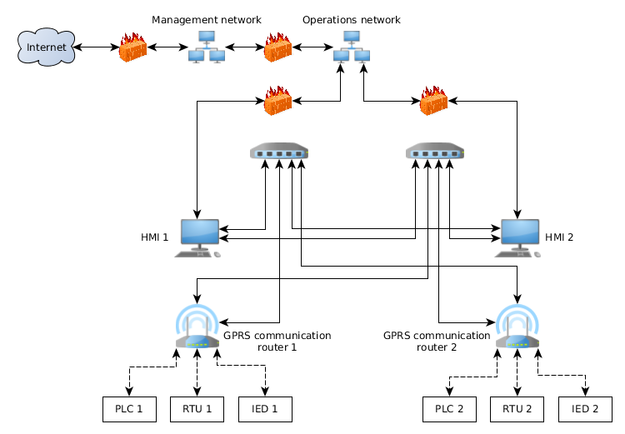
River Zonal Dispatcher Case Study
Without isolation

Slide 72
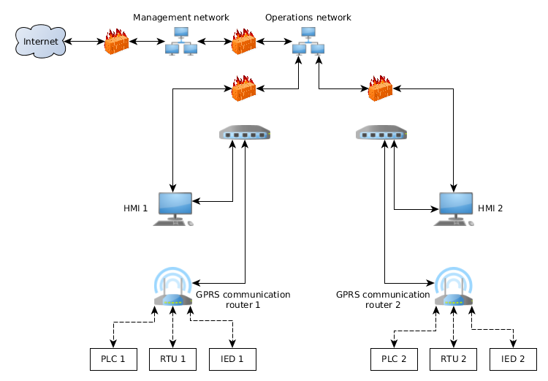
River Zonal Dispatcher Case Study
With isolation

Slide 73
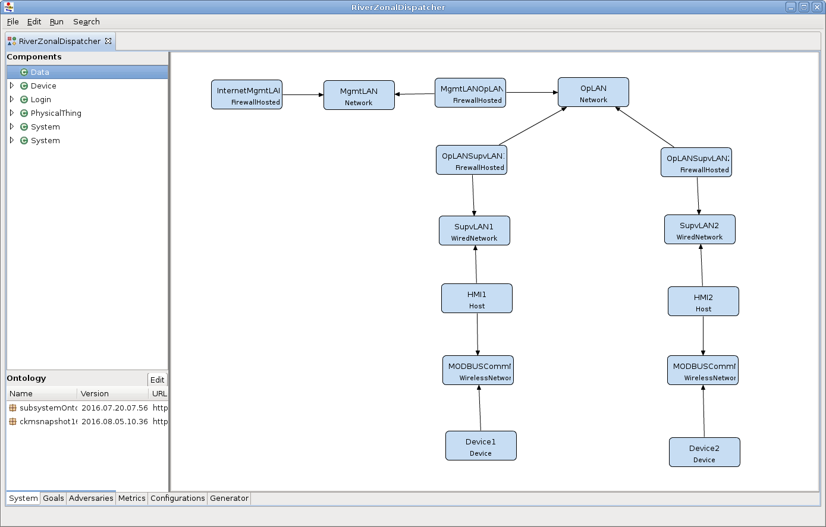
River Zonal Dispatcher Case Study

Slide 74
River Zonal Dispatcher Case Study
Model attack goals
Install malware on HMI
Compromise system via router
Compromise system via devices
Five adversaries are
Foreign government
Hacker
Hostile Organization
Insider Engineer
Insider Operator
Notes:
Foreign government
- Primarily concerned with installing backdoors on the HMIs and cares little about costs
Hacker
- Interested in most of the possible goals and is highly skilled, but must consider a balance of concern regarding cost, payoff, and detection
Hostile organization
- Highly skilled, but is interested only in compromising the supervisory LANs and is mostly seeking the best payoff
Insider engineer
- Interested in all goals, but is poorly skilled in attacks
Insider operator
- Has access to many parts of the system already, is highly skilled, and is primarily concerned with reprogramming the devices

Slide 75
River Zonal Dispatcher Case Study
Select metrics
Average Number of Successful Attacks
Probability of Attack Goals Achieved at End Time
Average Time-To-Achieve-Goal
Notes:
Average Number of Successful Attacks
- Defined for some key attack step of each component (looked at different attack paths and determined which one is key)
Probability of Attack Goals Achieved at End Time
- Installation of malware on HMI or router
- Disabling of devices
Average Time-To-Achieve-Goal

Slide 76
River Zonal Dispatcher Case Study
Generate and execute models
Set up 20 configurations for execution
  Each of 5 adversaries X 4 system models
  Calculate all metrics
Simulation models adversary behavior over 1 year
Ran 1,000 to 10,000 iterations

Slide 77
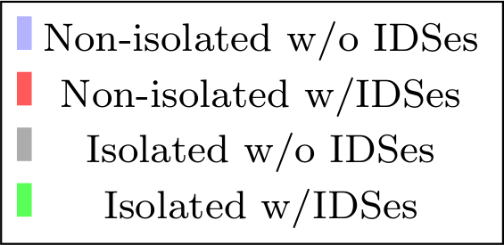
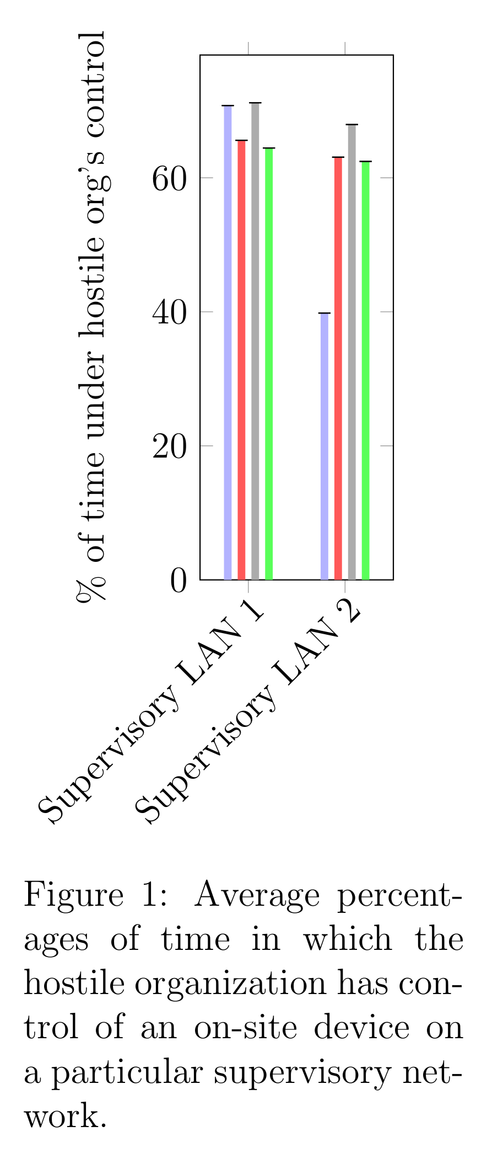
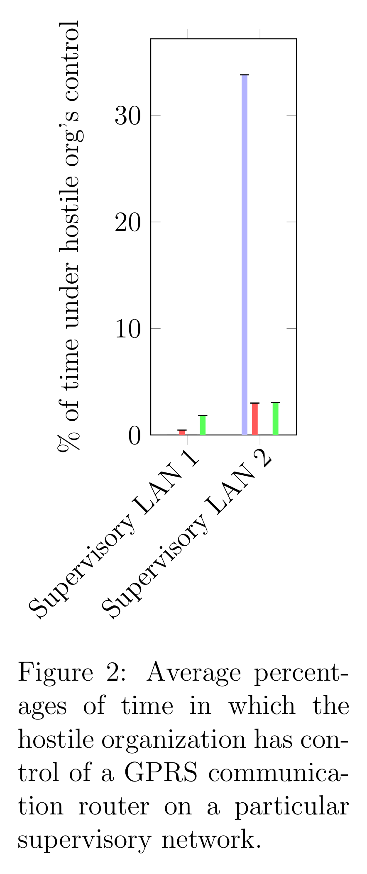
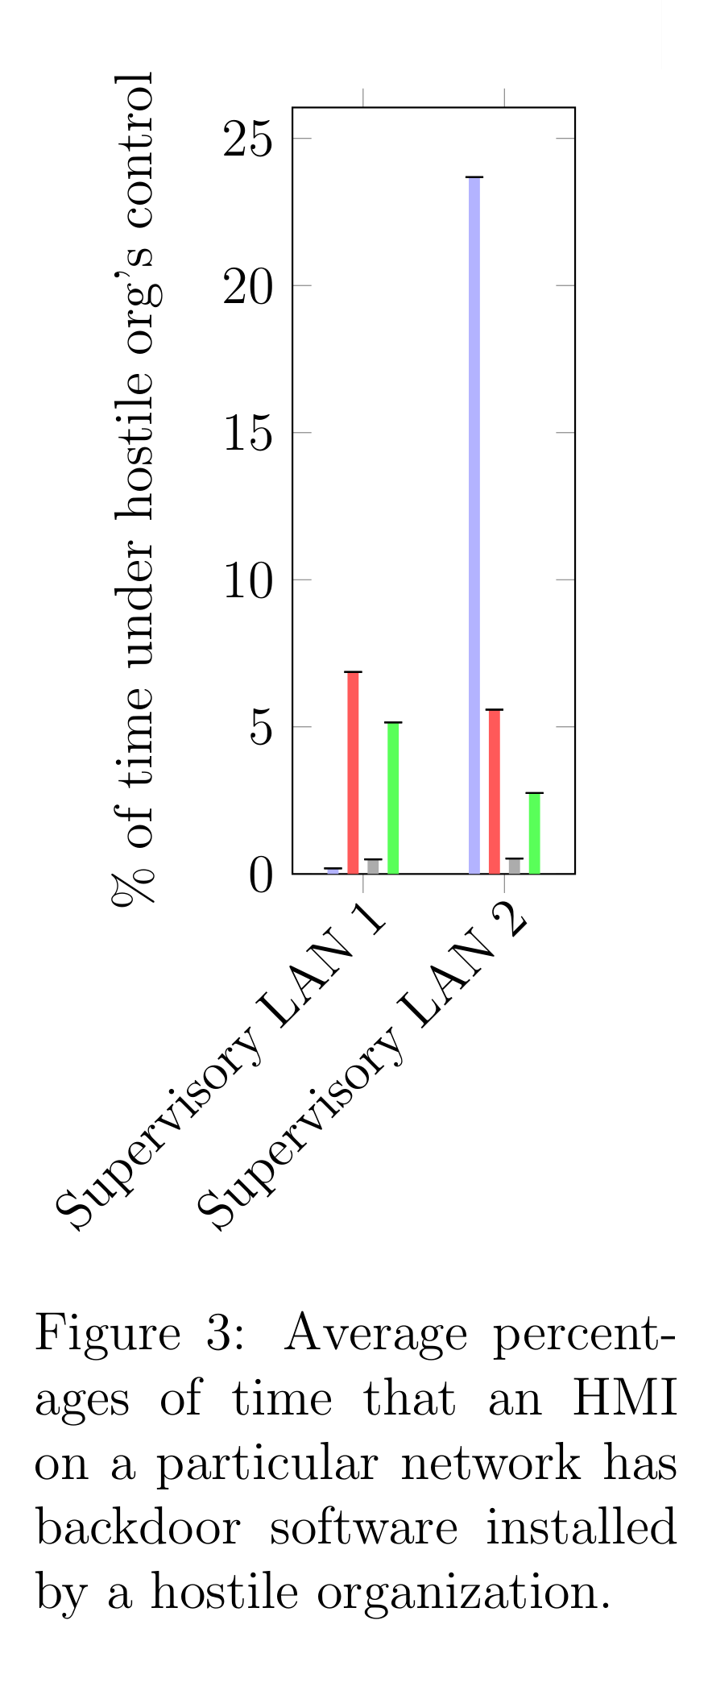
River Zonal Dispatcher Case Study
Results from hand-built model
Notes:
I wrote a case study paper for CRITIS and this was inspiration for the hand-built model. The paper will appear in CRITIS 2016, and to test out this model generation process, I've built it as a meta-model. In my results for the hand-generated model, I tested 5 different adversaries, but just to give you an example, for a hostile organization, these are the certain probabilities that they achieved control over the network. <Explain graphs>

Slide 78
River Zonal Dispatcher Case Study
Results from hand-built model
Greatest value seen in device attacks
Neither IDSes nor isolation effective in minimizing device attacks
IDSes very effective in minimizing router attacks and backdoor software installation on LAN 2 with non-isolated HMIs
Isolation effective in minimizing router attacks and backdoor software installation overall
LAN 2 preferred for router attacks and backdoor software installation, despite higher payoffs for attacks on LAN 1
Notes:
Reason for LAN 2 preference: response model

Slide 79
Advanced Metering Infrastructure Case Study
Define purpose of analysis
Determine the cost-effectiveness of different intrusion detection systems (IDSes) in an Advanced Metering Infrastructure (AMI) network.
In particular, compare
  Centralized IDS,
  Distributed IDS, and
  Embedded IDS.

Slide 80
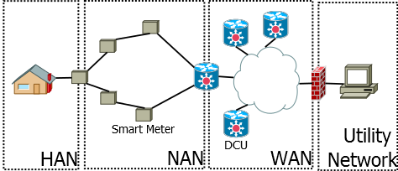
Advanced Metering Infrastructure Case Study
Define system components, relationship and attributes

Slide 81
Advanced Metering Infrastructure Case Study
Define system components, relationship and attributes

Slide 82
Advanced Metering Infrastructure Case Study
Define system components, relationship and attributes

Slide 83
Advanced Metering Infrastructure Case Study
Define system components, relationship and attributes

Slide 84
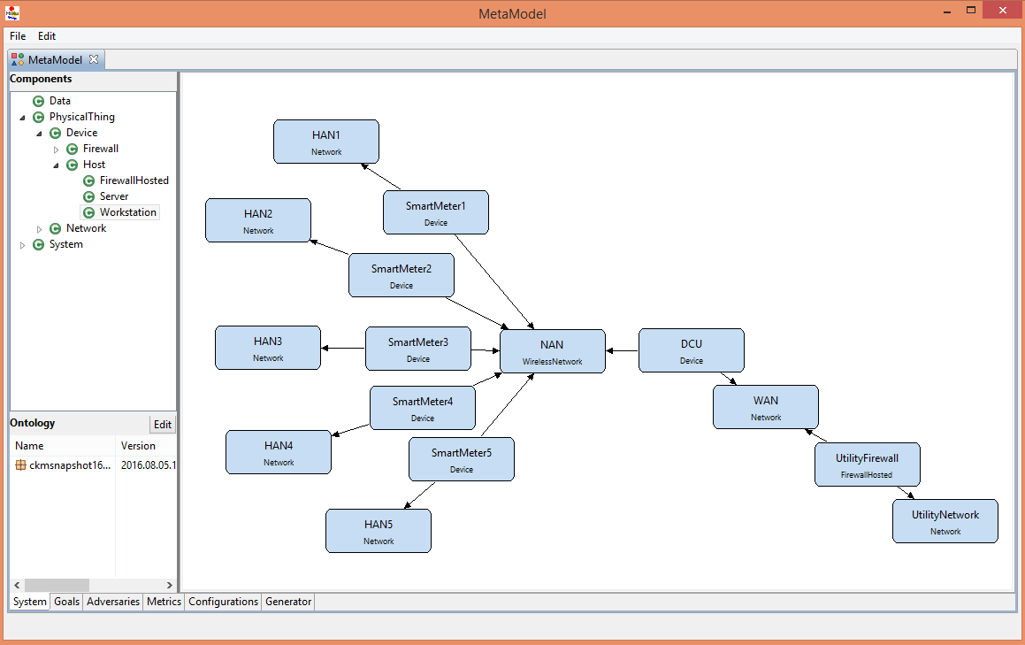
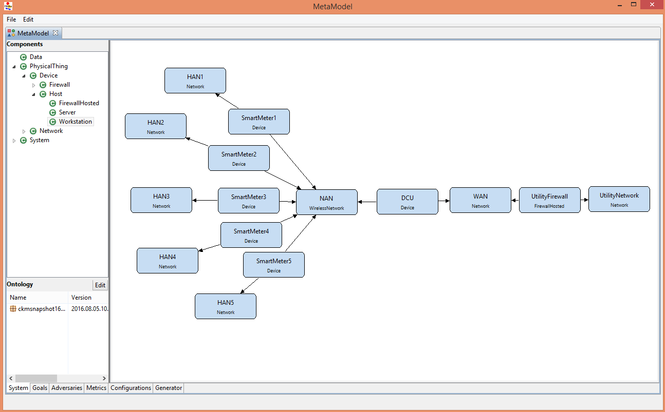
Advanced Metering Infrastructure Case Study

Slide 85
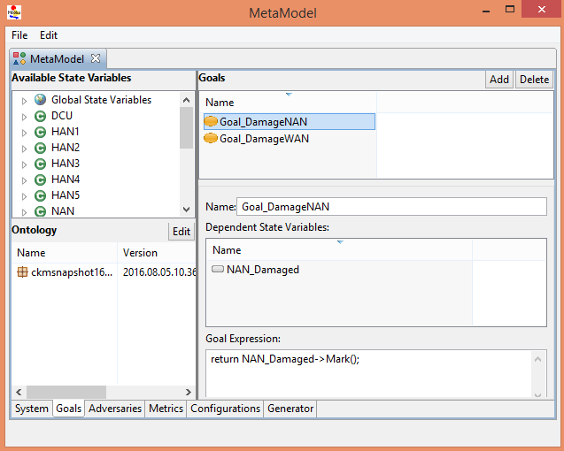
Advanced Metering Infrastructure Case Study
Model Attacker Goals

Slide 86
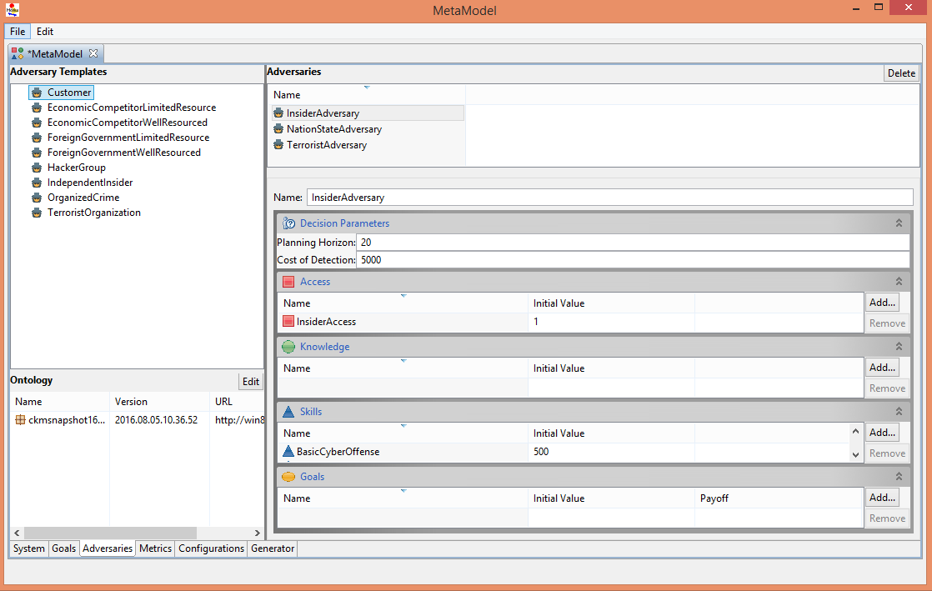
Advanced Metering Infrastructure Case Study
Model Adversaries

Slide 87
Advanced Metering Infrastructure Case Study
Select Metrics
Damage to System
Probability of Detecting Adversary
Attack Path

Slide 88
Advanced Metering Infrastructure Case Study
Create Configurations
Create one configuration for every pair of adversary/IDS, for a total of 3 adversaries X 4 IDS options = 12 configurations.

Slide 89
Advanced Metering Infrastructure Case Study
Results
IDS | Adversary | Attack | Monetary Damage
None | Insider Terrorist Nation-State | Routing Physical Routing | $1.07M $4.98M $876K
Centralized | Insider Terrorist Nation-State | Routing Physical Routing | $435K $4.98M $357K
Dedicated | Insider Terrorist Nation-State | None Physical None | $0 $4.98M $0
Embedded | Insider Terrorist Nation-State | None Physical None | $0 $5.02M $0

Slide 90
Agenda
Registration and Continental Breakfast
Welcome
Goals
  Tool
  Workshop
Steps to Use ADVISE Meta
Hands on Sessions
Case Studies and Custom Ontologies
Wrap Up

Slide 91
Wrap Up
General feedback
  Was this tool useful?
  How could you and your organization use it?
  What areas need work?
The Near Future
  Improvements to ADVISE/Actor Model
  Expanded Ontology
  System to Easily Share Ontology Packages
  Ontology Editor Improvements / Validation

Slide 92
Thank You!
Contact Info
  staff@mobius.illinois.edu
  http://www.mobius.illinois.edu

