Slide 1
ADVISE Meta – Alpha Tool Workshop
August 16, 2016
Andy Crap, Brett Feddersen, Alfredo Galbadon, Ken Keefe, Carol Muehrcke, Michael Rausch, Bill Sanders, and Ron Wright

Slide 2
Agenda
Registration and Continental Breakfast
Welcome
Goals
  Tool
  Workshop
Steps to Use ADVISE Meta
Hands on Sessions
Case Studies and Custom Ontologies
Wrap Up

Slide 3
ADVISE Meta Introduction
Today: no scientific basis for designing security architectures
  Follows from: no scientific basis for estimating effectiveness of security measures before deployment
Today: security metrics
  Before deployment, count countermeasures
    Judge effectiveness based on experience, intuition
  After deployment, count intrusions
Purpose of ADVISE Meta
  Provide scientific basis for design decisions by calculating security metrics at design time
  Auditable results
  No requirement for deep modeling or cybersecurity expertise

Slide 4
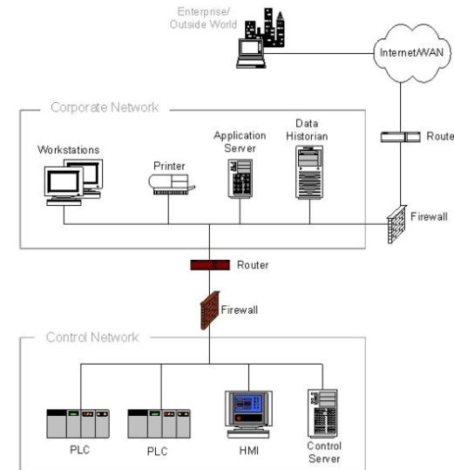
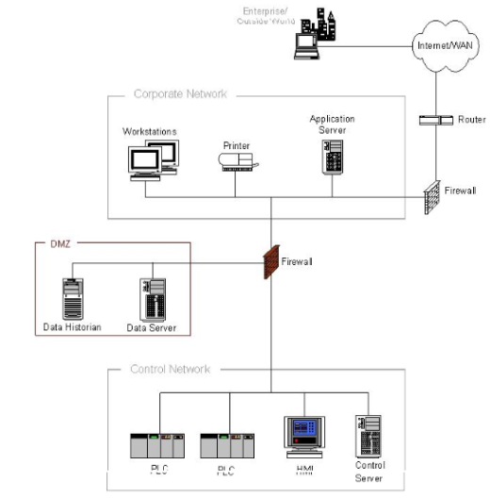
ADVISE Meta Tool
Compare architecture metrics: common attack paths, time to compromise, probability of compromise, cost of attack,…
Architecture 1
Architecture 1 Security metrics
Möbius SE
Tool
Architecture 2 Security metrics
Architecture 2
Attack simulation
Example architectures: NIST 800-82 Figures 5-2 and 5-3

Slide 5
Workshop Goals
Introduce the tool to the community, and to obtain feedback on the concept, functionality, usability, and future development priorities for the tool
How will obtain feedback from workshop

Slide 6
Agenda
Registration and Continental Breakfast
Welcome
Goals
  Tool
  Workshop
Steps to Use ADVISE Meta
Hands on Sessions
Case Studies and Custom Ontologies
Wrap Up

Slide 7
Using ADVISE Meta
Step 1:
Define purpose of analysis
‒Questions, concerns, scope
Step 2:
Model System(s)
‒Define system components, relationships and attributes
‒Hosts, devices, applications, data, networks, firewalls, authentication, other countermeasures
Step 3:
Model Attack Goals and
Adversaries
‒Goals: View/modify data, install malware, gain network access, disable device, damage device…
‒Select from standard adversary types or customize
‒Set adversary’s goal priorities
Step 4: Select Metrics
Step 5:
Generate and Execute Model
‒Generate attack execution graph
(possible attack paths)
‒ Generate and run simulation of adversary behavior
Step 6: Interpret Results
‒Metric Values
‒Visual Display of common attack paths

Slide 8
Hands On Sessions Agenda
Step 1:
Define purpose of analysis
9:30 – 9:45 AM
Step 2:
Model System(s)
9:45 – 10:45 AM
Break 10:45 – 11:00 AM
Step 3:
Model Attack Goals and
Adversaries
Goals 11:45 – 11:45 AM
Lunch 11:45 – 12:45 PM
Adversaries 12:45 – 1:30 PM
Step 4: Select Metrics
1:30 – 2:15 PM
Break 2:15 – 2:30 PM
Step 5:
Generate and Execute Model
2:30 – 3:15 PM
Step 6: Interpret Results

Slide 9
Agenda
Registration and Continental Breakfast
Welcome
Goals
  Tool
  Workshop
Steps to Use ADVISE Meta
Hands on Sessions
Case Studies and Custom Ontologies
Wrap Up

Slide 10
Step 1 – Define Purpose of Analysis
What can be analyzed?
With the base ontology: Enterprise system architectures that may have:
  Networks hosting cyber and cyber-physical devices
  Applications, data
  Internet connections
  Boundary protections and other common countermeasures
  Design phase or existing
With arbitrary ontology:
  In theory, any system built of components, where attacks are constructed by linking attack steps against components
What kinds of questions can be answered?
How susceptible is a system to cyber attacks?
What can be done to decrease susceptibility?
Typical examples of analyses
Which of two security architectures should be recommended?
What are the security weak points of an architecture?
Is a proposed countermeasure worthwhile?
How will proposed functional architecture changes impact security?

Slide 11
Example Enterprise Systems
Architecture to support stock trading
SCADA architecture supporting an electric utility
Control systems in a water treatment plant
Operations and administration systems for a telecommunications provider
911 computer systems architecture
Reactor safety architecture for a nuclear power plant
Systems in a hospital that process patient information
Air traffic or train control systems
Computer infrastructure for a research and development facility
Computer infrastructure for an ISP

Slide 12
Example Problem Name – Step 1
Define purpose of analysis
Describe example problem

Slide 13
Step 1 – Define Purpose of Analysis - Feedback
Open questions/discussion on Step 1
  Take notes here during meeting
Questions for group:
  What are some typical security architecture decisions for which rationale is hard to come by?
  Are there specific systems that don’t fall under enterprise systems, but that might benefit from this type of analysis?

Slide 14
Step 2 – Model Systems
Brief background information on basic modeling concepts – concept of Mobius project, ontology, components, relationships, attributes, etc.

Slide 15
Example Problem Name – Step 2
Model systems
High level description of system to be modeled
Any special advice about modeling the example
Pointer to document with hands on steps to carry out

Slide 16
Step 2 – Model Systems – Feedback

Slide 17
Step 3 – Attack Goals and Adversaries
Explain how goals and adversaries are supported by the tool, cover topics:
  state variables, code expressions to create goals
  Standard adversaries, what can be changed, what can be added (component specific skills, accesses, knowledge)

Slide 18
Example Problem Name – Step 3
Attack goals and adversaries
High level description of goals and adversaries to be modeled
Any special advice about modeling the example
Pointer to document with hands on steps to carry out

Slide 19
Step 3 – Attack Goals and Adversaries – Feedback

Slide 20
Step 4 – Metrics
Explain how metrics are supported by the tool, cover topics:
  Reward model and performance variable concepts (if needed)
  Standard metrics
  Capability to define custom metrics

Slide 21
Example Problem Name – Step 4
Select metrics
High level description of metrics to be selected
Pointer to document with hands on steps to carry out

Slide 22
Step 4 – Metrics – Feedback

Slide 23
Step 5 – Execute Models
Explain high level concepts related to execution
Somehow show brief definitions, relationships and use of the following high level concepts to tie it all together. Pictures best. Explain related windows and how shown in project tree.
Project
Project Component
ADVISE MetaModel
ADVISE Model
Attack Execution Graph
Reward Model
Simulator
Study – experiment (very brief)
Configuration

Slide 24
Example Problem Name – Step 5
Execute models
High level description of configurations to be created
Pointer to document with hands on steps to carry out

Slide 25
Step 5 – Execute Models – Feedback

Slide 26
Step 6 – Interpret Results
Describe types of results available, how to analyze them

Slide 27
Example Problem Name – Step 6
Interpret results
High level description of how to go about finding and interpreting results of example
Pointer to document with hands on steps to carry out

Slide 28
Step 6 – Interpret Results – Feedback

Slide 29
Agenda
Registration and Continental Breakfast
Welcome
Goals
  Tool
  Workshop
Steps to Use ADVISE Meta
Hands on Sessions
Case Studies and Custom Ontologies
Wrap Up

Slide 30
Recloser Radios Case Study Step 1
Define purpose of analysis
Investigate the effects on system security, of architectural changes to an electric power distribution system.
In particular, analyze the security impact of increased connectivity within the smart grid.
  Adding recloser radios allows communication between poletop reclosers and substations.
    Faster response and repair time is good.
    More attack vectors is bad (but how bad?).

Slide 31
Recloser Radios Case Study Step 2
SCADA Control Center
Internet
Firewall
Corporate LAN
Firewall
SCADA
LAN
Engineering Facility
SCADA Communication Network
Engineering Workstation
Firewall
Substation
Engineering
Remote Access Network
Communication Gateway
HMI
Use non proprietary version
Poletop
Recloser Radio
Recloser
Radio Network
Recloser
GE Proprietary

Slide 32
Recloser Radios Case Study Step 2
Model systems
Two systems: with and without recloser radios
Highlights of models:
  Five networks, some firewalled, some not
  Three applications can modify substation settings
  Copied model without recloser radios and added them to create second model
  Etc.

Slide 33
Recloser Radios Case Study Step 3
Model attack goals and adversaries
Damage equipment, disrupt electricity service, install malware
Six adversaries are:
Highlights of models:
  Standard adversary profiles with initial accesses added, how these vary among adversaries
  Mention if any component-specific skills are added
  How adversaries vary in goals and skill proficiencies

Slide 34
Recloser Radios Case Study Step 4
Select metrics (all standard available metrics)
Average Number of Attempts
  Report for each attack step (maybe not all)
  Gives insight on preferred attack path of adversary
Probability of Attack Goal Achieved at End Time
  Report for each attack goal
  Gives insight on what goals the adversary is actively pursuing and reaching
Average Time-To-Achieve-Goal
  For attack goals where the above probability metric is 1 (or close to 1)
  Gives insight on the speed of the adversary’s attack

Slide 35
Recloser Radios Case Study Step 5
Generate and execute models
Set up 12 configurations for execution
  Each of 6 adversaries X 2 system models
  Calculate all metrics

Slide 36
Recloser Radios Case Study Step 6
Interpret Results
Answer questions posed, explain key metrics and how provided that answer

Slide 37
Ontology is Data
Base ontology used for hands-on exercise
  Representative of tool capabilities
  Not yet a “complete” or vetted dataset
  Fully modifiable by tool user
A “library designer” may:
  Add to or modify base ontology
  Define new ontology
Example – add attack steps
  Malware
    CreateRemovableMediaCauseMalwareInstall
    Stage PackageCauseMalwareInstall
    InstallMalwareFromRemovableMedia
    InstallMalwareFromFixedMedia
  Denial-of-service
    PhysicalDisconnect
    NetworkFlood
  Data-related
    Exfiltrate data

Slide 38
Ontology is Data (cont.)
Example - add component types with unique defaults, attributes, and/or attack steps
  Virtual OS – build model of data center
  ATM machine – build model of banking organization
  Smartmeter – build model of planned smart grid architecture
Example – modify formulas used to calculate attack step characteristics
  Probability of success/failure of attack step
  Detectability of an attack step outcome
  Cost of attack step
  Time to execute attack step
Example – build ontology to model internal architecture of a modern electric vehicle together with associated charging stations

Slide 39
River Zonal Dispatcher Case Study
Define purpose of analysis
Add slides for other steps similar to recloser radios
Open questions/discussion on case study
  Take notes here during meeting
Questions for group:
  See slide 13 for examples

Slide 40
Advanced Metering Infrastructure Case Study
Define purpose of analysis
Add slides for other steps similar to recloser radios
Open questions/discussion on case study
  Take notes here during meeting
Questions for group:
  See slide 13 for examples

Slide 41
Agenda
Registration and Continental Breakfast
Welcome
Goals
  Tool
  Workshop
Steps to Use ADVISE Meta
Hands on Sessions
Case Studies and Custom Ontologies
Wrap Up

Slide 42
Wrap Up
Open discussion with the group, or specific questions might be prepared
What’s next for the project
Contact info

